Slide 1

지진원 특성평가 Characterization of Seismic Sources - Part II -
Supreme Course I

Slide 2
Chapter 5 Earthquake Catalog

Slide 3
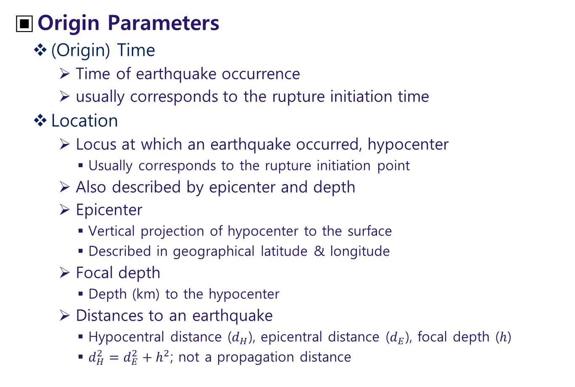
Preparation of Catalog
Origin Parameters
(Origin) Time
Time of earthquake occurrence
usually corresponds to the rupture initiation time
Location
Locus at which an earthquake occurred, hypocenter
Usually corresponds to the rupture initiation point
Also described by epicenter and depth
Epicenter
Vertical projection of hypocenter to the surface
Described in geographical latitude & longitude
Focal depth
Depth (km) to the hypocenter
Distances to an earthquake
Hypocentral distance ($d_{H}$), epicentral distance ($d_{E}$), focal depth ($h$)
$d_{H}^{2}=d_{E}^{2}+h^{2}$; not a propagation distance

Slide 4
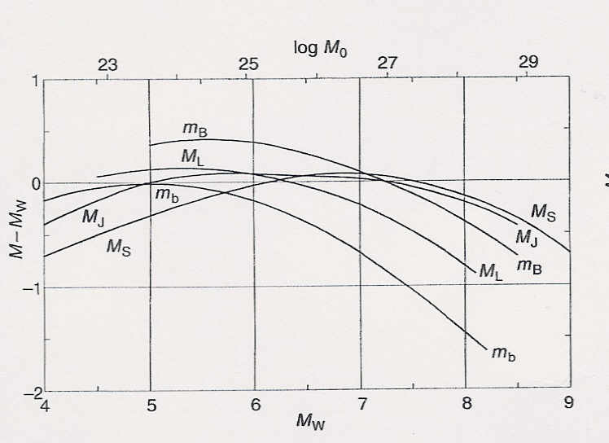
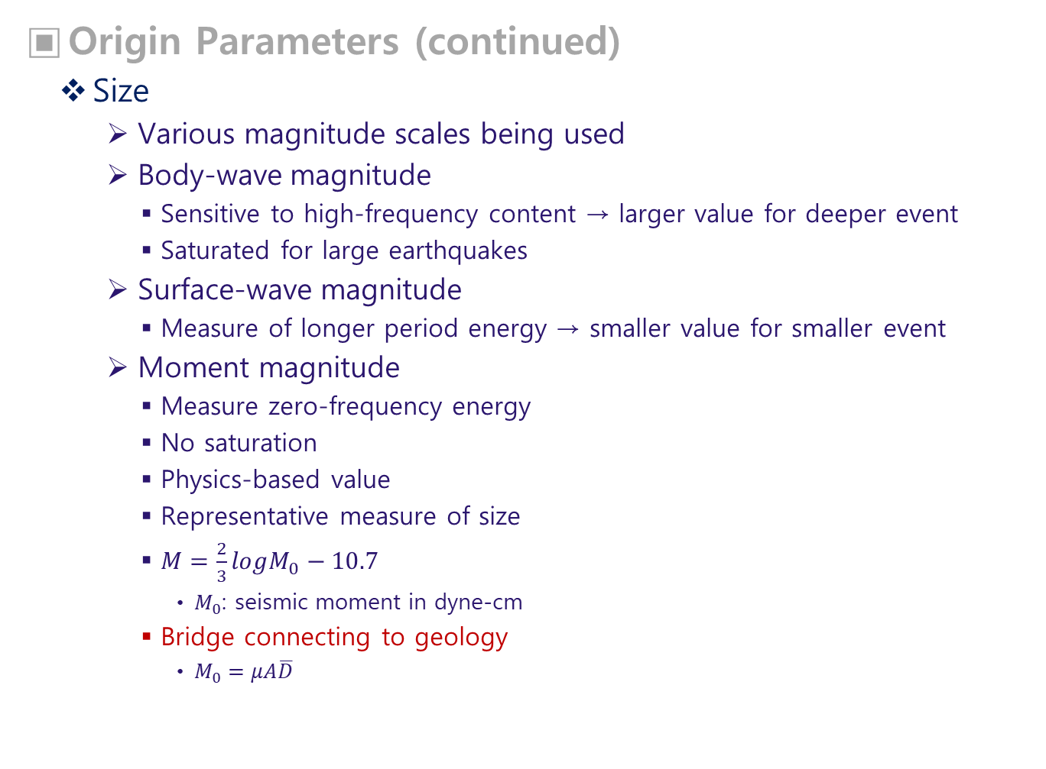
Origin Parameters (continued)
Size
Various magnitude scales being used
Body-wave magnitude
Sensitive to high-frequency content → larger value for deeper event
Saturated for large earthquakes
Surface-wave magnitude
Measure of longer period energy → smaller value for smaller event
Moment magnitude
Measure zero-frequency energy
No saturation
Physics-based value
Representative measure of size
$M=\frac{2}{3}logM_{0}−10.7$
$M_{0}$: seismic moment in dyne-cm
Bridge connecting to geology
$M_{0}=μA\overline{D}$

Slide 5
Integration of Catalogs
To expand earthquake data by combining various catalogs covering different periods, different regions (ergodic assumption)
General requirements
Description by unified quantities
Accuracy assessment
Important properties to be checked
Unification of description
origin times
Use of UTC (Coordinated Universal Time) or a single local time
Unification of magnitude scale
Use of a single magnitude scale: moment magnitude is preferred
Accuracy checks
Error range of magnitude
Error range of location

Slide 6
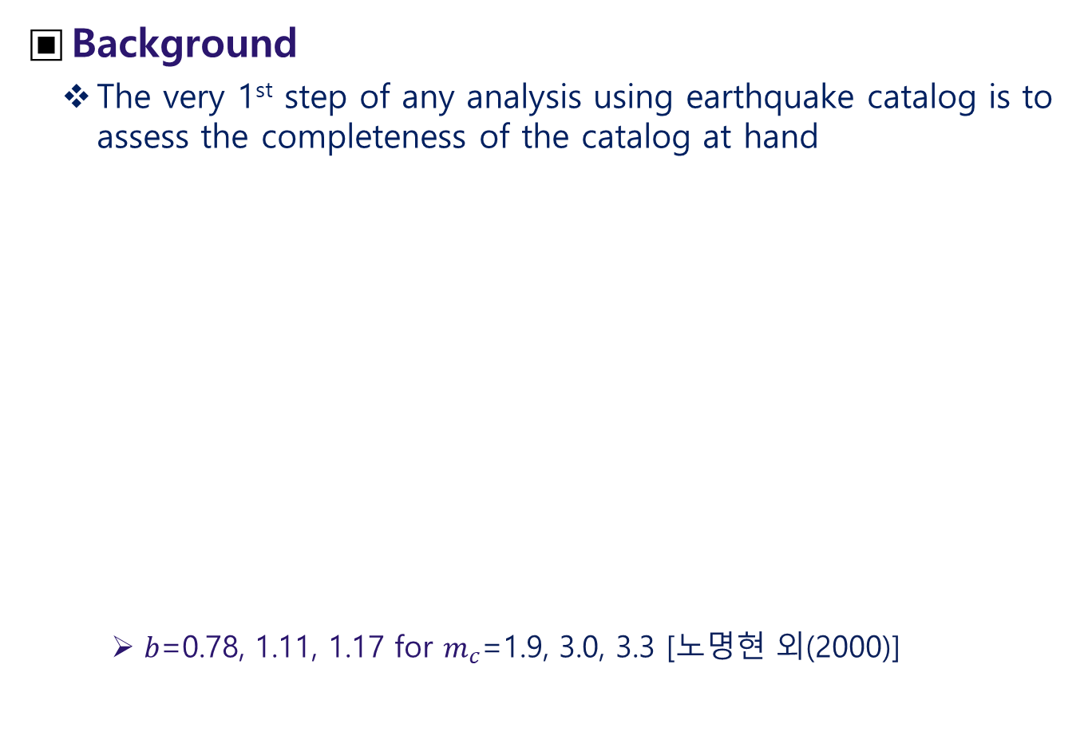
Completeness Assessment of Catalog
Background
The very 1st step of any analysis using earthquake catalog is to assess the completeness of the catalog at hand
$b$=0.78, 1.11, 1.17 for $m_{c}$=1.9, 3.0, 3.3 [노명현 외(2000)]

Slide 7
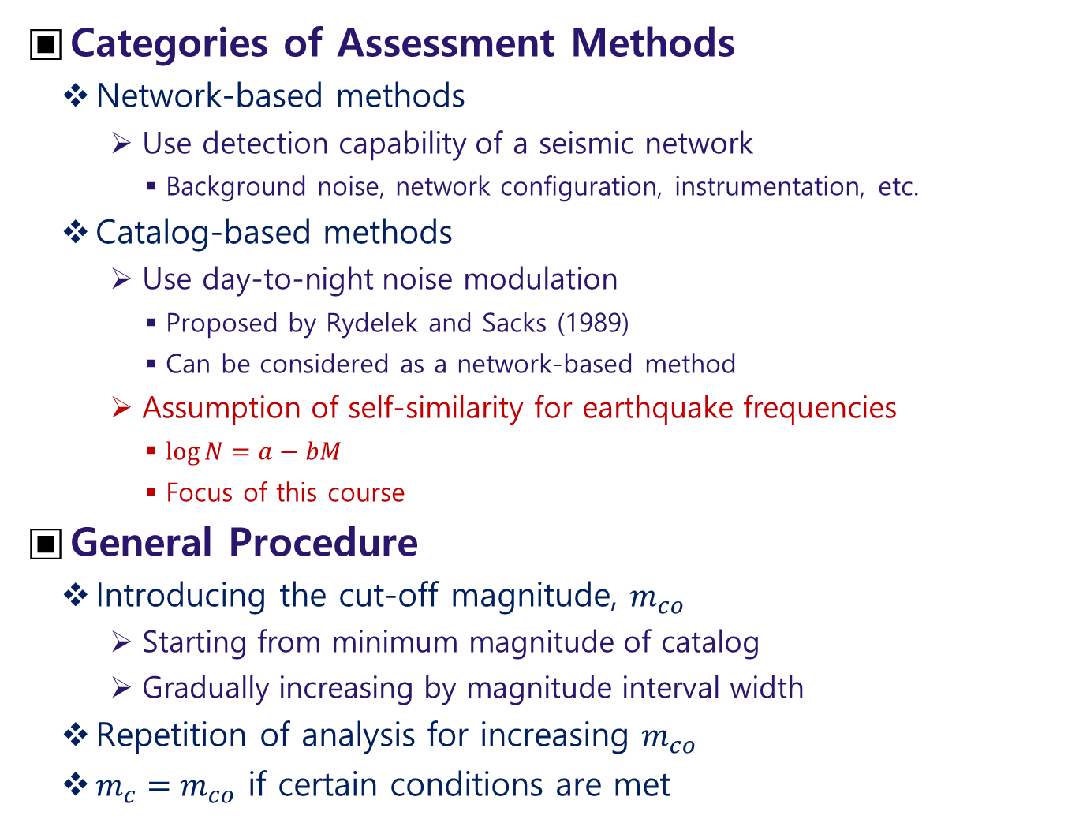
Categories of Assessment Methods
Network-based methods
Use detection capability of a seismic network
Background noise, network configuration, instrumentation, etc.
Catalog-based methods
Use day-to-night noise modulation
Proposed by Rydelek and Sacks (1989)
Can be considered as a network-based method
Assumption of self-similarity for earthquake frequencies
$\log{N}=a−bM$
Focus of this course
General Procedure
Introducing the cut-off magnitude, $m_{co}$
Starting from minimum magnitude of catalog
Gradually increasing by magnitude interval width
Repetition of analysis for increasing $m_{co}$
$m_{c}=m_{co}$ if certain conditions are met

Slide 8
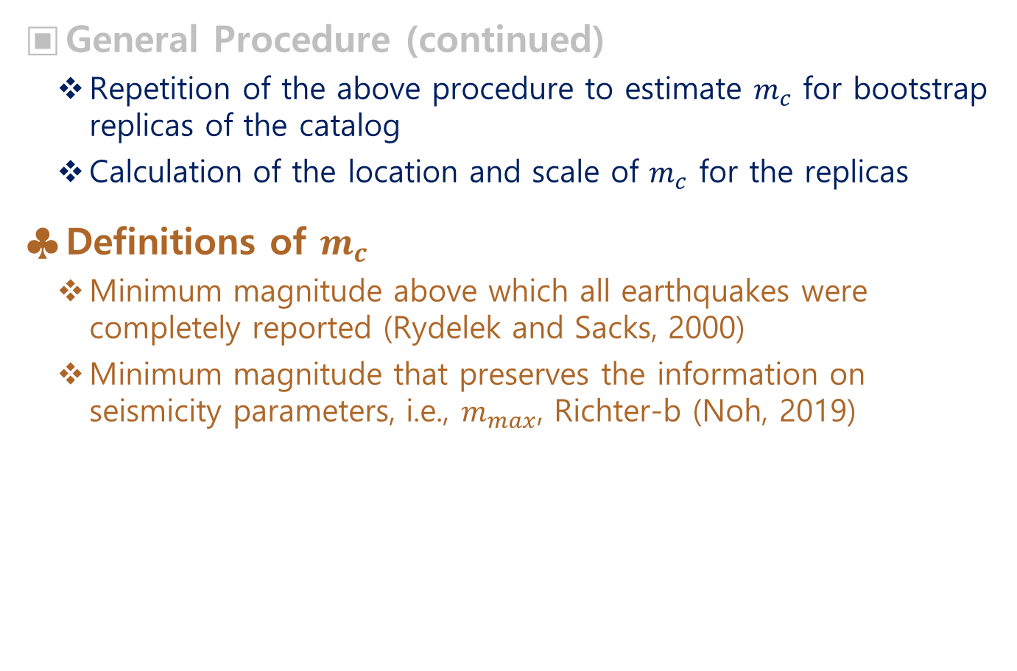
General Procedure (continued)
Repetition of the above procedure to estimate $m_{c}$ for bootstrap replicas of the catalog
Calculation of the location and scale of $m_{c}$ for the replicas
Definitions of $m_{c}$
Minimum magnitude above which all earthquakes were completely reported (Rydelek and Sacks, 2000)
Minimum magnitude that preserves the information on seismicity parameters, i.e., $m_{max}$, Richter-b (Noh, 2019)

Slide 9
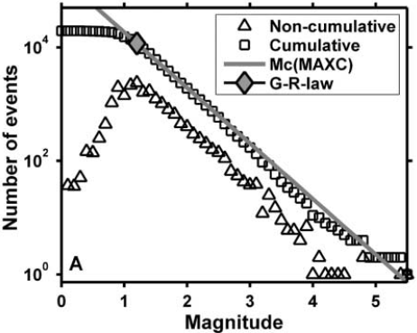
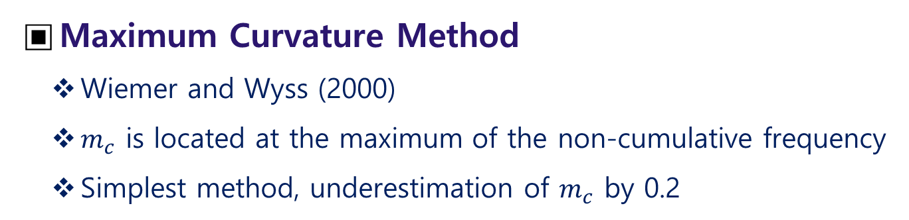
Maximum Curvature Method
Wiemer and Wyss (2000)
$m_{c}$ is located at the maximum of the non-cumulative frequency
Simplest method, underestimation of $m_{c}$ by 0.2

Slide 10
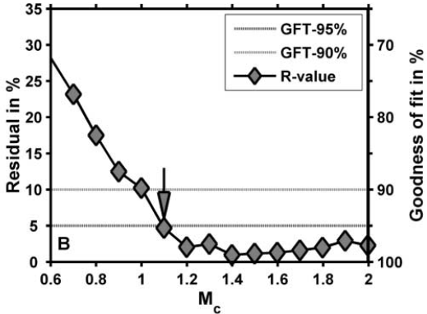
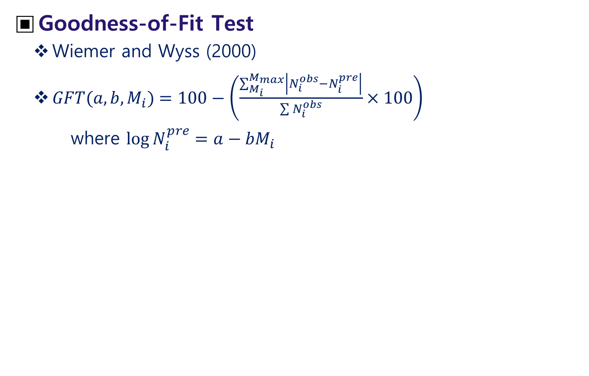
Goodness-of-Fit Test
Wiemer and Wyss (2000)
$GFT(a,b,M_{i})=100−\left(\frac{\sum_{M_{i}}^{M_{max}}{\left|N_{i}^{obs}−N_{i}^{pre}\right|}}{\sum{N_{i}^{obs}}}×100\right)$
where $\log{N_{i}^{pre}}=a−bM_{i}$

Slide 11
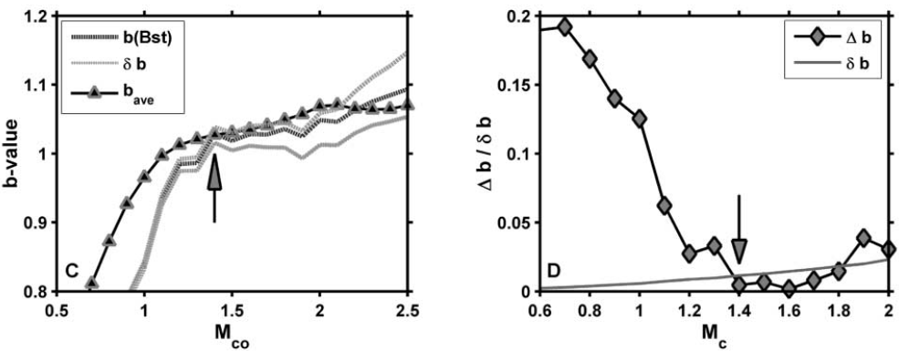
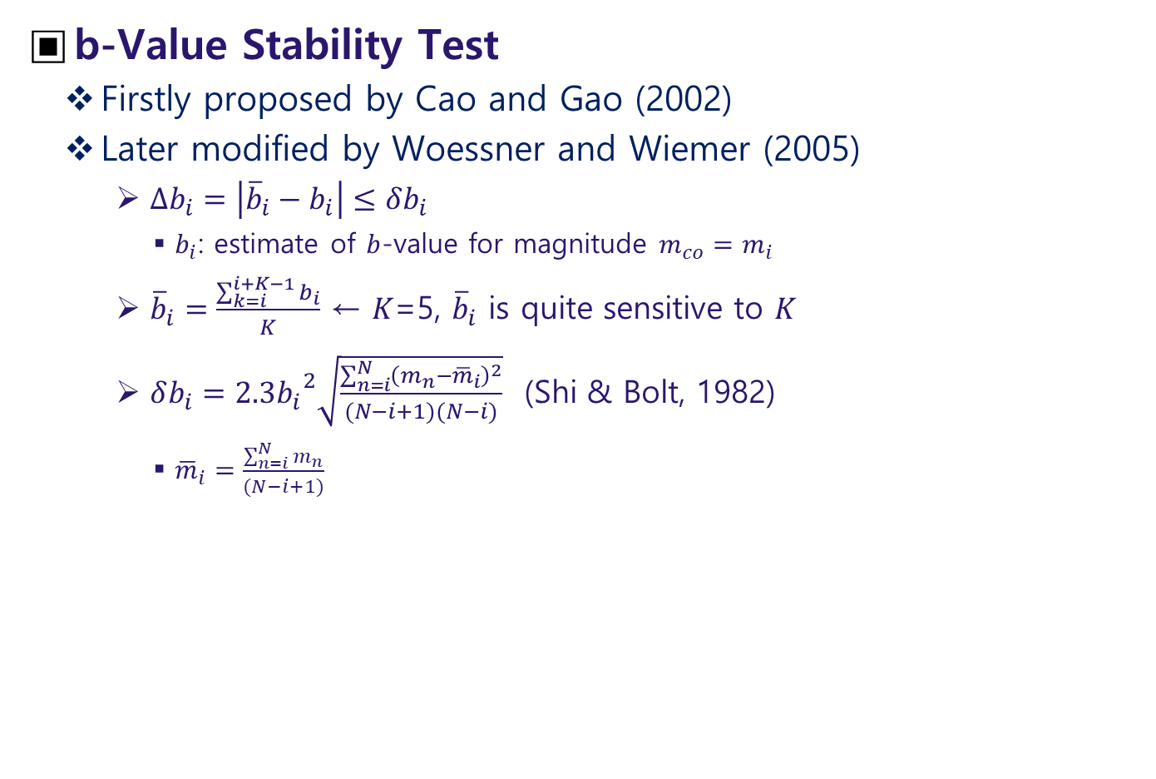
b-Value Stability Test
Firstly proposed by Cao and Gao (2002)
Later modified by Woessner and Wiemer (2005)
$Δb_{i}=\left|{\overline{b}}_{i}−b_{i}\right|≤δb_{i}$
$b_{i}$: estimate of $b$-value for magnitude ${m_{co}=m}_{i}$
${\overline{b}}_{i}=\frac{\sum_{k=i}^{i+K−1}{b_{i}}}{K}$ ← $K$=5, ${\overline{b}}_{i}$ is quite sensitive to $K$
$δb_{i}=2.3{b_{i}}^{2}\sqrt{\frac{\sum_{n=i}^{N}{{\left(m_{n}−{\overline{m}}_{i}\right)}^{2}}}{(N−i+1)(N−i)}}$ (Shi & Bolt, 1982)
${\overline{m}}_{i}=\frac{\sum_{n=i}^{N}{m_{n}}}{(N−i+1)}$

Slide 12
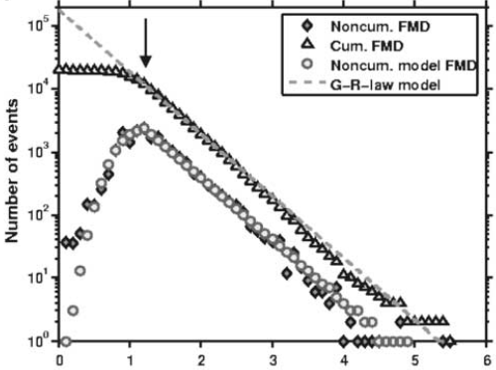
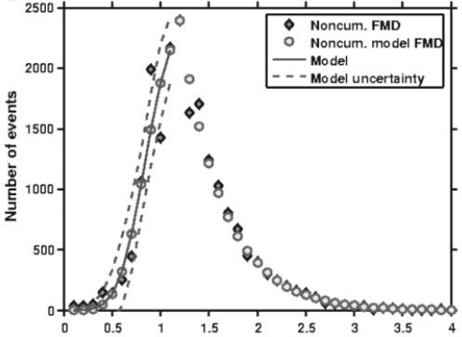
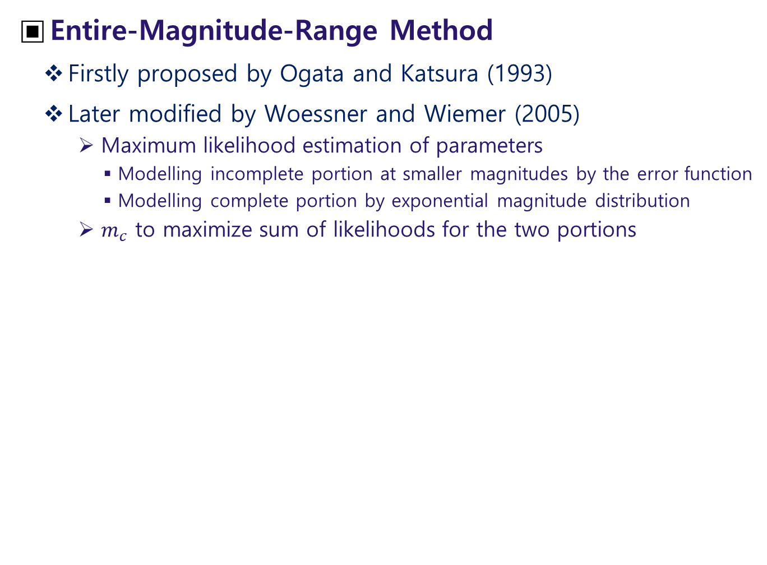
Entire-Magnitude-Range Method
Firstly proposed by Ogata and Katsura (1993)
Later modified by Woessner and Wiemer (2005)
Maximum likelihood estimation of parameters
Modelling incomplete portion at smaller magnitudes by the error function
Modelling complete portion by exponential magnitude distribution
$m_{c}$ to maximize sum of likelihoods for the two portions

Slide 13
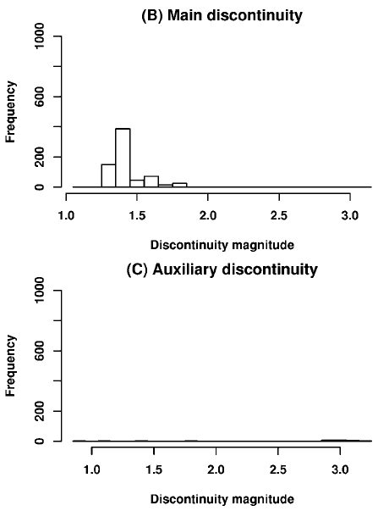
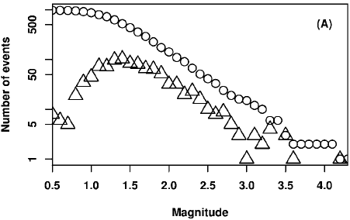
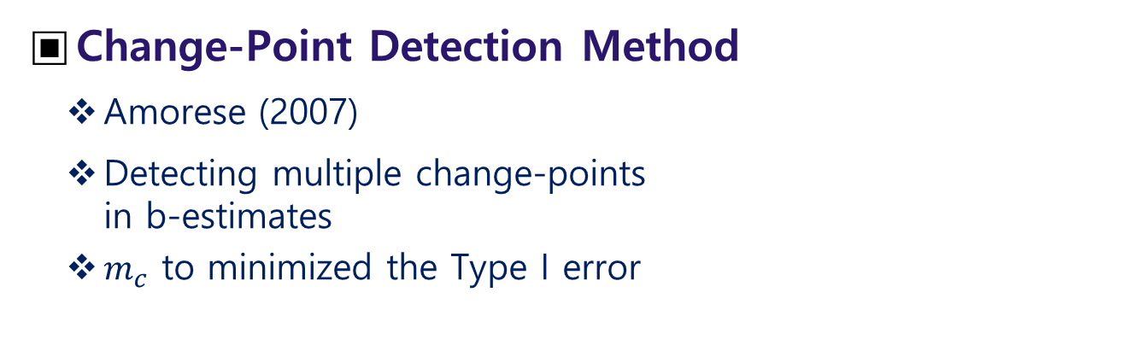
Change-Point Detection Method
Amorese (2007)
Detecting multiple change-points in b-estimates
$m_{c}$ to minimized the Type I error

Slide 14
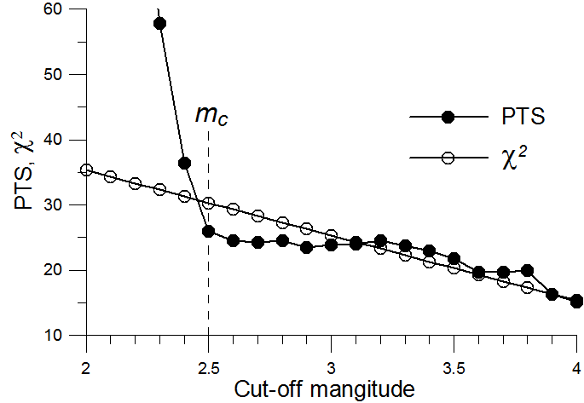
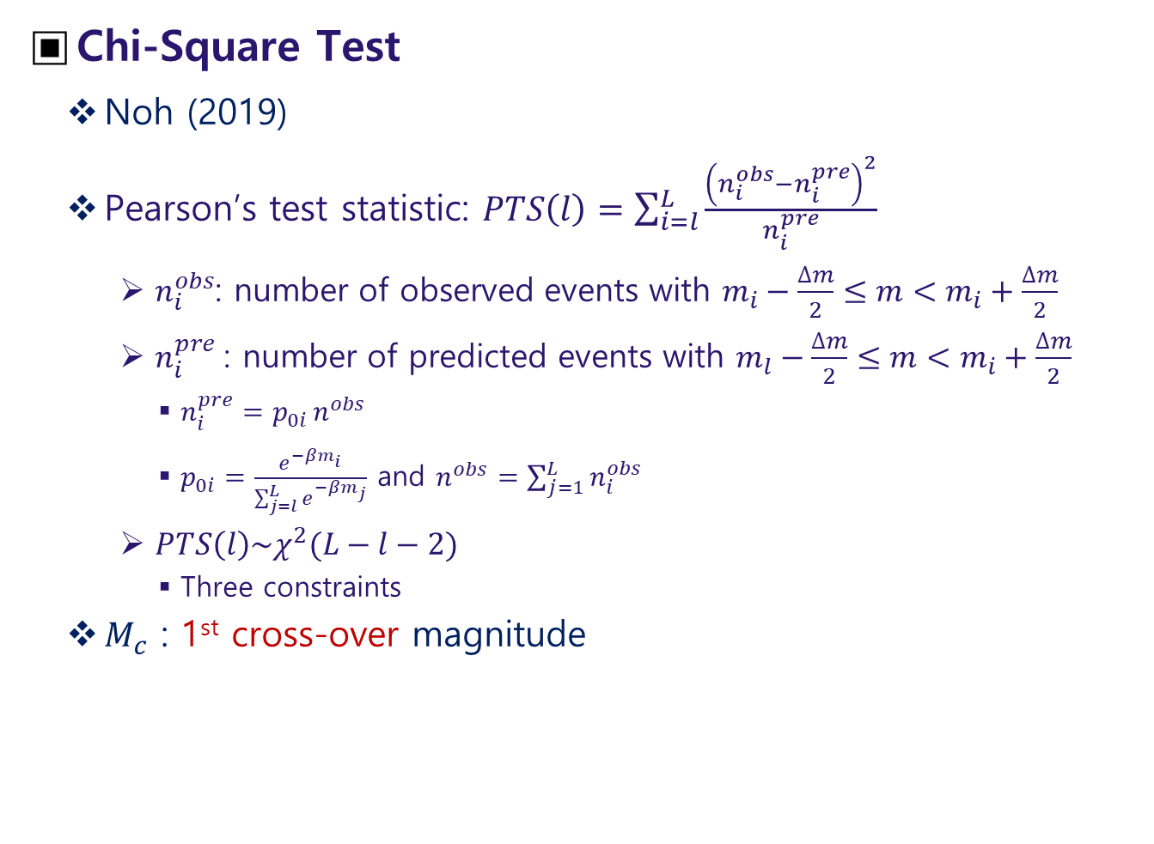
Chi-Square Test
Noh (2019)
Pearson’s test statistic: $PTS\left(l\right)=\sum_{i=l}^{L}{\frac{{\left(n_{i}^{obs}−n_{i}^{pre}\right)}^{2}}{n_{i}^{pre}}}$
$n_{i}^{obs}$: number of observed events with $m_{i}−\frac{∆m}{2}≤m<m_{i}+\frac{∆m}{2}$
$n_{i}^{pre}$: number of predicted events with $m_{l}−\frac{∆m}{2}≤m<m_{i}+\frac{∆m}{2}$
$n_{i}^{pre}=p_{0i }n^{obs}$
$p_{0i}=\frac{e^{−βm_{i}}}{\sum_{j=l}^{L}{e^{−βm_{j}}}}$ and $n^{obs}=\sum_{j=1}^{L}{n_{i}^{obs}}$
$PTS\left(l\right)\sim χ^{2}(L−l−2)$
Three constraints
$M_{c}$ : 1st cross-over magnitude

Slide 15
Chapter 6 Characterization of Seismic Sources - Catalog Based -

Slide 16
Introduction
Major Seismicity Parameters
Maximum magnitude, Richter-b, annual occurrence rate
Seismic vs. Geologic Approaches
Seismicity-Based Approaches (Probabilistic)
Open the only option in regions with limited seismic record and limited geological investigations
Particularly useful for constraining rates of small to moderate events that do not provide surface evidence
Geological Approaches (Deterministic)
Works well in active areas with a significant history of earthquake occurrence and geological investigations
Particularly useful for constraining rates of the largest events with surface evidences
Cross Check
If two approaches are available, their estimates can be used for the cross check

Slide 17
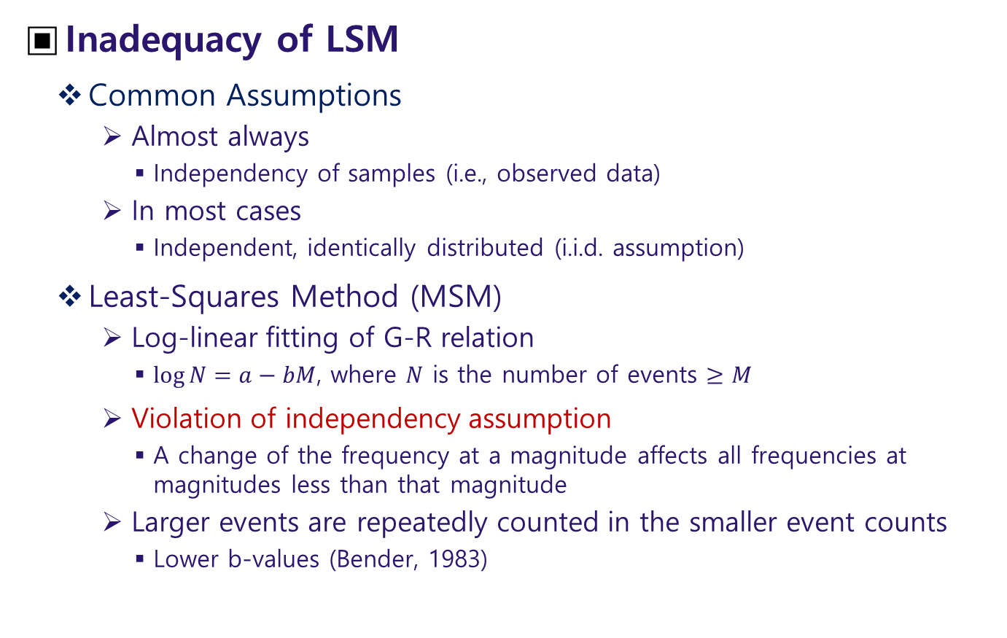
Inadequacy of LSM
Common Assumptions
Almost always
Independency of samples (i.e., observed data)
In most cases
Independent, identically distributed (i.i.d. assumption)
Least-Squares Method (MSM)
Log-linear fitting of G-R relation
$\log{N}=a−bM$, where $N$ is the number of events $≥M$
Violation of independency assumption
A change of the frequency at a magnitude affects all frequencies at magnitudes less than that magnitude
Larger events are repeatedly counted in the smaller event counts
Lower b-values (Bender, 1983)

Slide 18
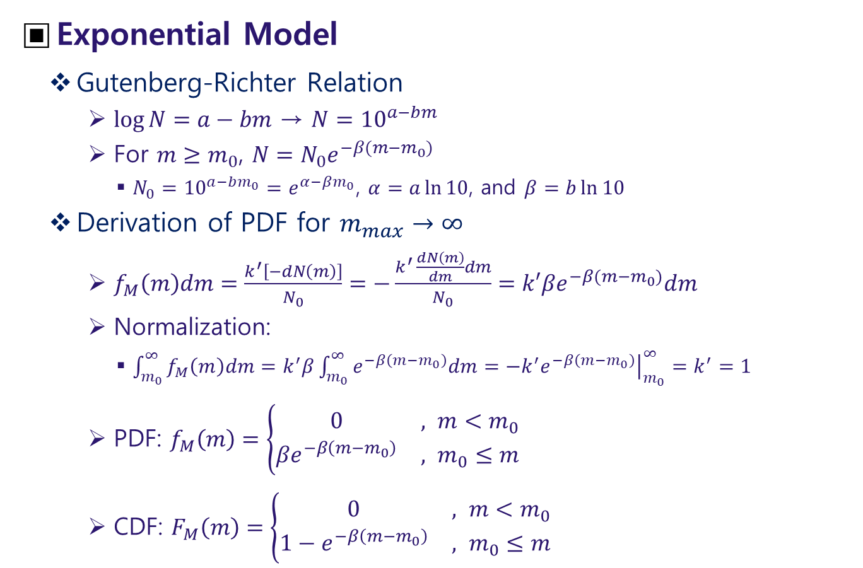
Magnitude Distribution
Exponential Model
Gutenberg-Richter Relation
$\log{N}=a−bm$ → $N={10}^{a−bm}$
For $m≥m_{0}$, $N=N_{0}e^{−β(m−m_{0})}$
$N_{0}={10}^{a−bm_{0}}=e^{α−βm_{0}}$, $α=a\ln{10}$, and $β=b\ln{10}$
Derivation of PDF for $m_{max}→∞$
$f_{M}\left(m\right)dm=\frac{k^{′}\left[−dN\left(m\right)\right]}{N_{0}}=−\frac{k^{′ }\frac{dN\left(m\right)}{dm}dm}{N_{0}}=k′βe^{−β(m−m_{0})}dm$
Normalization:
$\int_{m_{0}}^{∞}{f_{M}\left(m\right)dm}=k^{′}β\int_{m_{0}}^{∞}{e^{−β\left(m−m_{0}\right)}dm}=−k^{′}{\left.e^{−β\left(m−m_{0}\right)}\right|}_{m_{0}}^{∞}=k^{′}=1$
PDF: $f_{M}\left(m\right)=\left\{\begin{matrix}0 & , m<m_{0} \\ {βe}^{−β\left(m−m_{0}\right)} & , m_{0}≤m\end{matrix}\right.$
CDF: $F_{M}\left(m\right)=\left\{\begin{matrix}0 & , m<m_{0} \\ {1−e}^{−β\left(m−m_{0}\right)} & , m_{0}≤m\end{matrix}\right.$

Slide 19
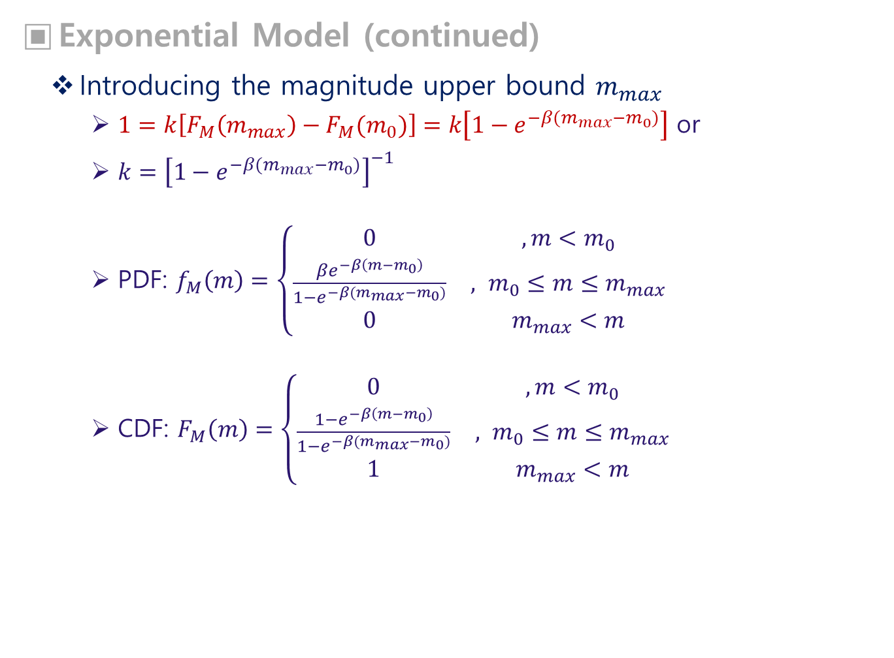
Exponential Model (continued)
Introducing the magnitude upper bound $m_{max}$
$1=k\left[F_{M}\left(m_{max}\right)−F_{M}(m_{0})\right]=k\left[1−e^{−β(m_{max}−m_{0})}\right]$ or
$k={\left[1−e^{−β(m_{max}−m_{0})}\right]}^{−1}$
PDF: $f_{M}\left(m\right)=\left\{\begin{matrix}0 & ,m<m_{0} \\ \frac{{βe}^{−β\left(m−m_{0}\right)}}{1−e^{−β(m_{max}−m_{0})}} & , m_{0}≤m≤m_{max} \\ 0 & m_{max}<m\end{matrix}\right.$
CDF: $F_{M}\left(m\right)=\left\{\begin{matrix}0 & ,m<m_{0} \\ \frac{{1−e}^{−β\left(m−m_{0}\right)}}{1−e^{−β(m_{max}−m_{0})}} & , m_{0}≤m≤m_{max} \\ 1 & m_{max}<m\end{matrix}\right.$

Slide 20
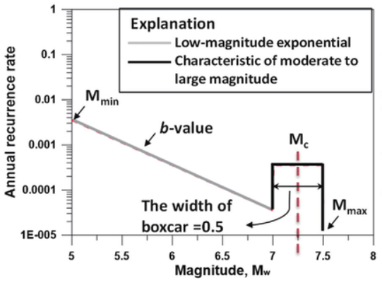
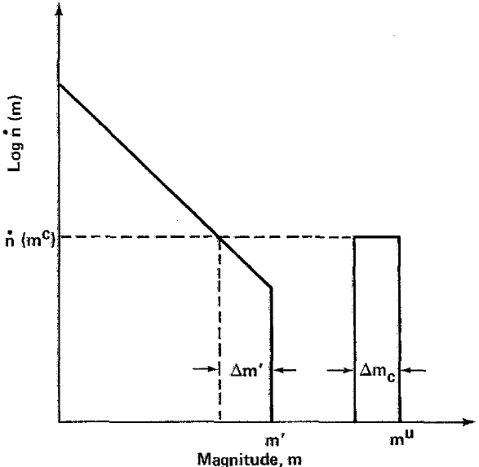
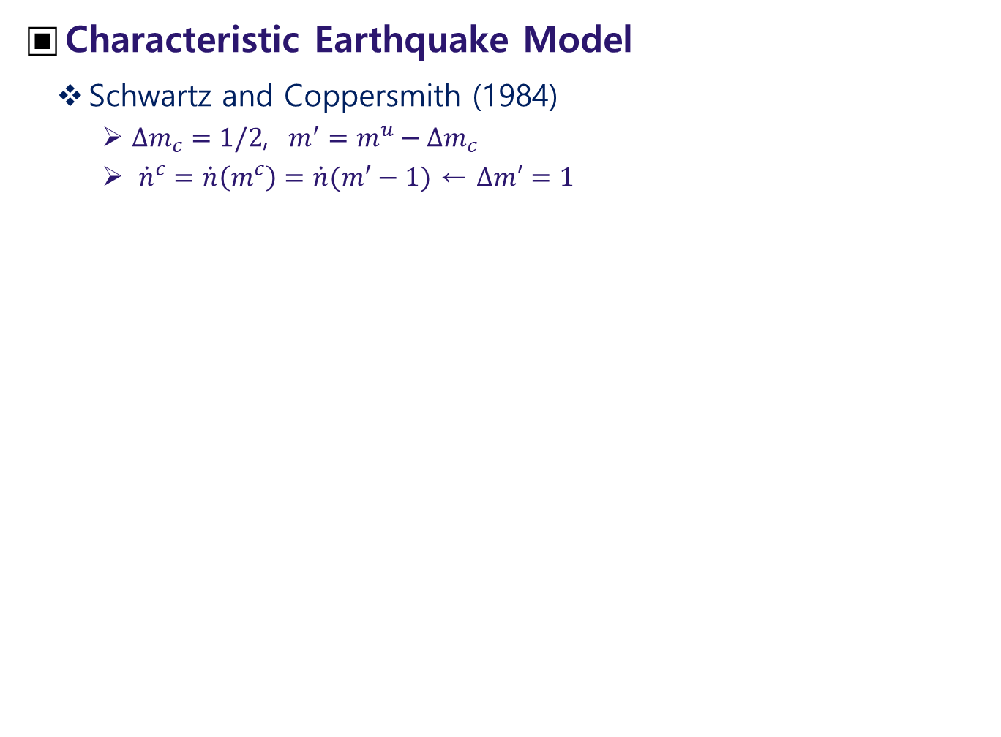
Characteristic Earthquake Model
Schwartz and Coppersmith (1984)
$∆m_{c}=1/2$, $m^{′}=m^{u}−∆m_{c}$
${\dot{n}}^{c}=\dot{n}\left(m^{c}\right)=\dot{n}(m^{′}−1)$ ← $∆m′=1$

Slide 21
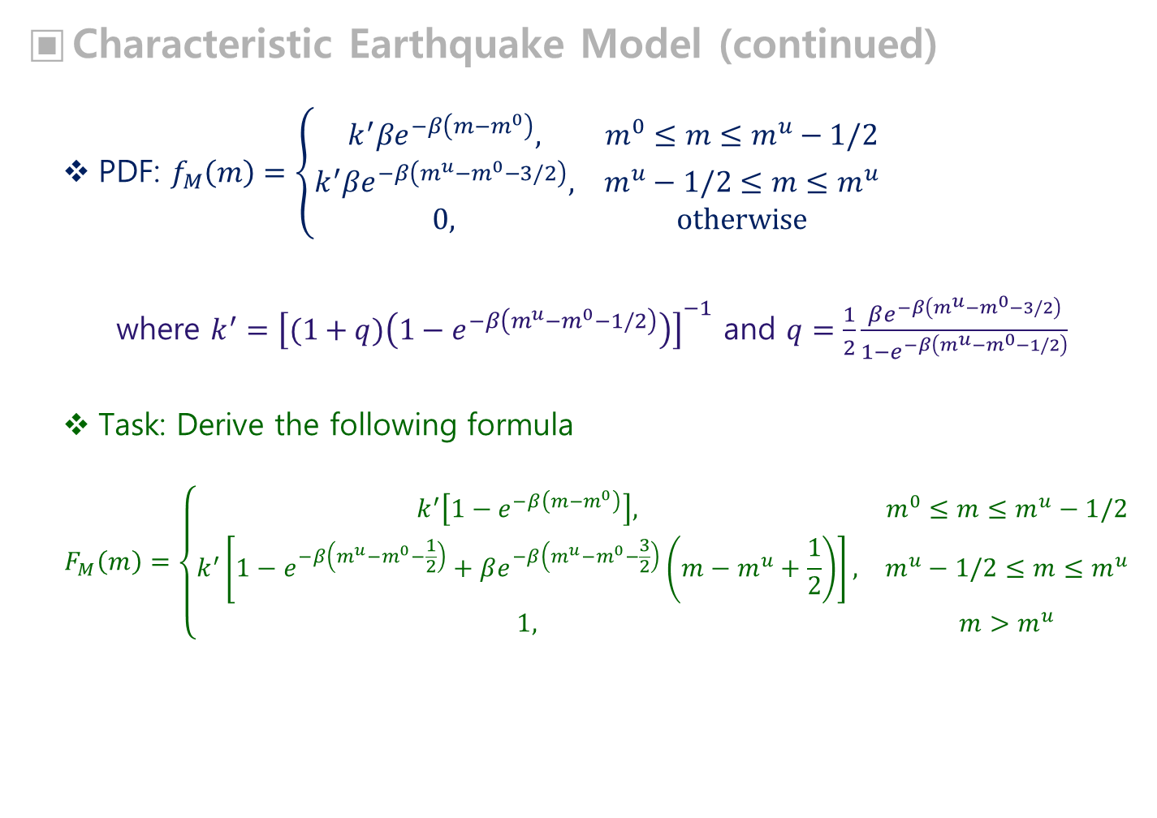
Characteristic Earthquake Model (continued)
PDF: $f_{M}\left(m\right)=\left\{\begin{matrix}k^{′}βe^{−β\left(m−m^{0}\right)}, & m^{0}≤m≤m^{u}−1/2 \\ k^{′}βe^{−β\left(m^{u}−m^{0}−3/2\right)}, & m^{u}−1/2≤m≤m^{u} \\ 0, & otherwise\end{matrix}\right.$
where $k^{′}={\left[(1+q)\left(1−e^{−β\left(m^{u}−m^{0}−1/2\right)}\right)\right]}^{−1}$ and $q=\frac{1}{2}\frac{βe^{−β\left(m^{u}−m^{0}−3/2\right)}}{1−e^{−β\left(m^{u}−m^{0}−1/2\right)}}$
Task: Derive the following formula
$$F_{M}\left(m\right)=\left\{\begin{matrix}k^{′}\left[1−e^{−β\left(m−m^{0}\right)}\right], & m^{0}≤m≤m^{u}−1/2 \\ k^{′}\left[1−e^{−β\left(m^{u}−m^{0}−\frac{1}{2}\right)}+βe^{−β\left(m^{u}−m^{0}−\frac{3}{2}\right)}\left(m−m^{u}+\frac{1}{2}\right)\right], & m^{u}−1/2≤m≤m^{u} \\ 1, & m>m^{u}\end{matrix}\right.$$

Slide 22
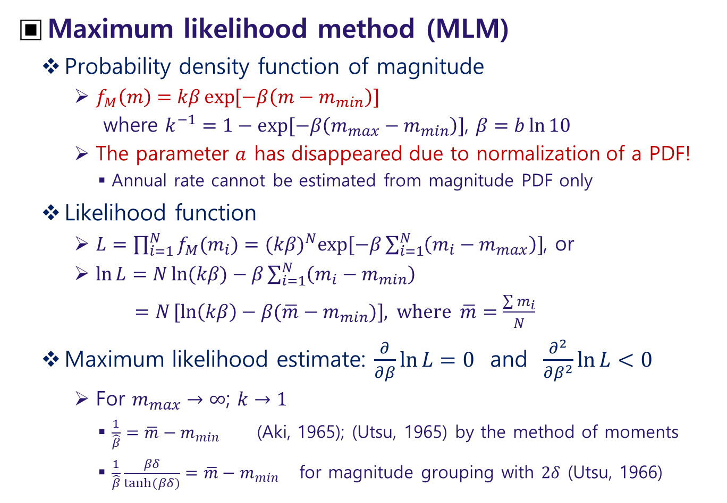
Estimation of Richter-b
Maximum likelihood method (MLM)
Probability density function of magnitude
$f_{M}\left(m\right)=kβ\exp{[−β\left(m−m_{min}\right)]}$
where $k^{−1}=1−exp⁡[−β\left(m_{max}−m_{min}\right)]$, $β=b\ln{10}$
The parameter $a$ has disappeared due to normalization of a PDF!
Annual rate cannot be estimated from magnitude PDF only
Likelihood function
$L=\prod_{i=1}^{N}{f_{M}(m_{i})}=(kβ)^{N}exp⁡[−β\sum_{i=1}^{N}{\left(m_{i}−m_{max}\right)}]$, or
$\ln{L}=N\ln{(kβ)}−β\sum_{i=1}^{N}{\left(m_{i}−m_{min}\right)}$
$=N[ln\left(kβ\right)−β(\overline{m}−m_{min})]$, where $\overline{m}=\frac{\sum{m_{i}}}{N}$
Maximum likelihood estimate: $\frac{∂}{∂β}\ln{L}=0$ and $\frac{∂^{2}}{∂β^{2}}\ln{L}<0$
For $m_{max}→∞$; $k→1$
$\frac{1}{\hat{β}}=\overline{m}−m_{min}$ (Aki, 1965); (Utsu, 1965) by the method of moments
$\frac{1}{\hat{β}}\frac{βδ}{tanh⁡(βδ)}=\overline{m}−m_{min}$ for magnitude grouping with $2δ$ (Utsu, 1966)

Slide 23
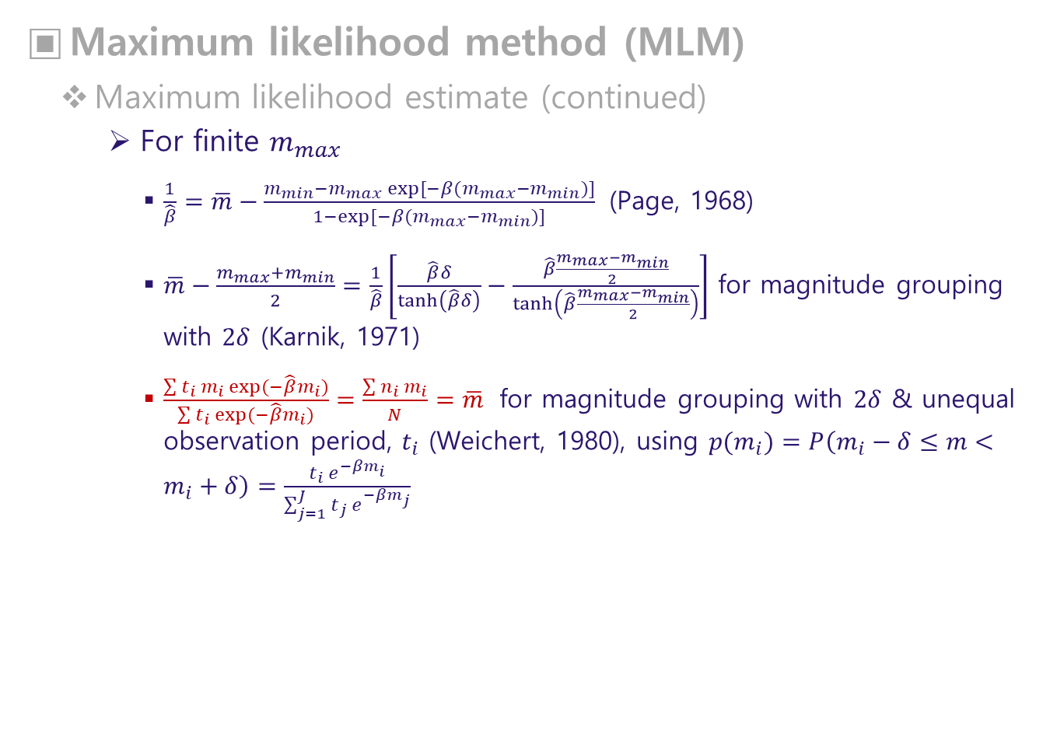
Maximum likelihood method (MLM)
Maximum likelihood estimate (continued)
For finite $m_{max}$
$\frac{1}{\hat{β}}=\overline{m}−\frac{m_{min}−m_{max} exp⁡[−β(m_{max}−m_{min})]}{1−exp⁡[−β(m_{max}−m_{min})]}$ (Page, 1968)
$\overline{m}−\frac{m_{max}+m_{min}}{2}=\frac{1}{\hat{β}}\left[\frac{\hat{β}δ}{\tanh\left(\hat{β}δ\right)}−\frac{\hat{β}\frac{m_{max}−m_{min}}{2}}{\tanh\left(\hat{β}\frac{m_{max}−m_{min}}{2}\right)}\right]$ for magnitude grouping with $2δ$ (Karnik, 1971)
$\frac{\sum{t_{i}{ m}_{i} exp⁡(−\hat{β}m_{i})}}{\sum{t_{i} exp⁡(−\hat{β}m_{i})}}=\frac{\sum{n_{i} m_{i}}}{N}=\overline{m}$ for magnitude grouping with $2δ$ & unequal observation period, $t_{i}$ (Weichert, 1980), using ${p(m}_{i})=P\left(m_{i}−δ≤m<m_{i}+δ\right)=\frac{t_{i} e^{−βm_{i}}}{\sum_{j=1}^{J}{t_{j} e^{−βm_{j}}}}$

Slide 24
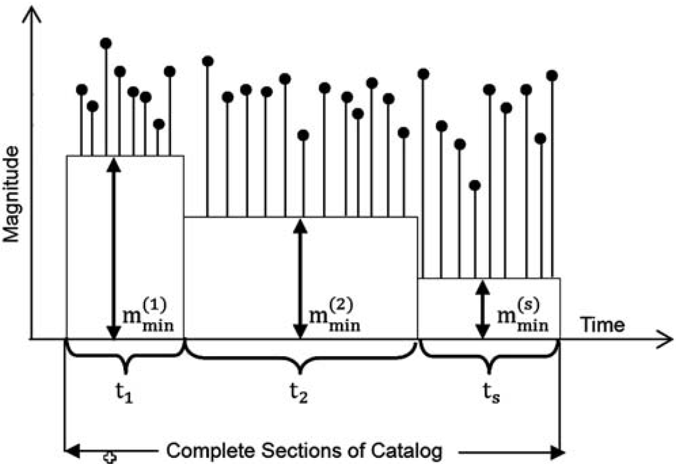
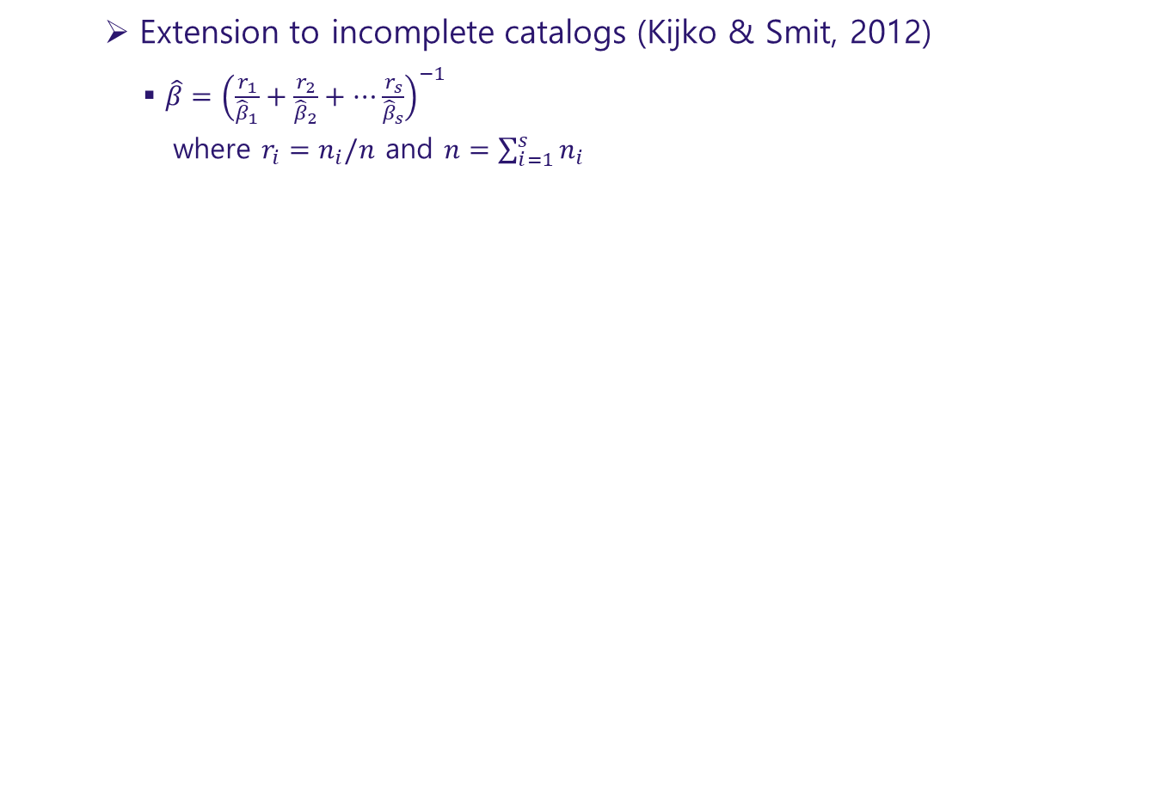
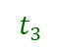
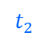
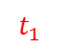
Extension to incomplete catalogs (Kijko & Smit, 2012)
$\hat{β}={\left(\frac{r_{1}}{{\hat{β}}_{1}}+\frac{r_{2}}{{\hat{β}}_{2}}+⋯\frac{r_{s}}{{\hat{β}}_{s}}\right)}^{−1}$
where $r_{i}=n_{i}/n$ and $n=\sum_{i=1}^{s}{n_{i}}$
$$t_{1}$$
$$t_{2}$$
$$t_{3}$$

Slide 25
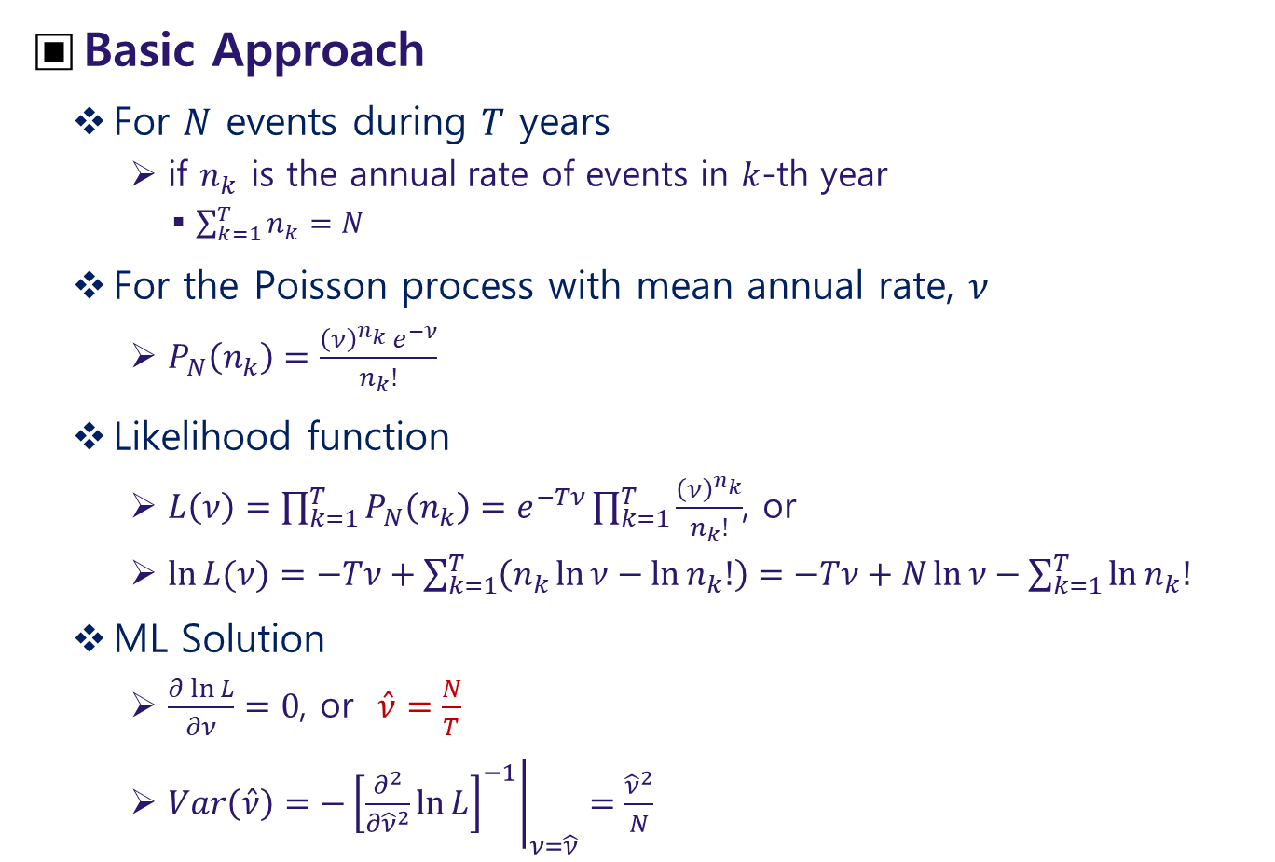
Estimation of Annual Rate
Basic Approach
For $N$ events during $T$ years
if $n_{k}$ is the annual rate of events in $k$-th year
$\sum_{k=1}^{T}{n_{k}}=N$
For the Poisson process with mean annual rate, $ν$
$P_{N}\left(n_{k}\right)=\frac{{\left(ν\right)}^{n_{k}} e^{−ν}}{n_{k}!}$
Likelihood function
$L\left(ν\right)=\prod_{k=1}^{T}{P_{N}\left(n_{k}\right)}=e^{−Tν}\prod_{k=1}^{T}{\frac{{\left(ν\right)}^{n_{k}}}{n_{k}!}}$, or
$\ln{L(ν)}=−Tν+\sum_{k=1}^{T}{\left(n_{k}\ln{ν}−\ln{n_{k}!}\right)}=−Tν+N\ln{ν}−\sum_{k=1}^{T}{\ln{n_{k}!}}$
ML Solution
$\frac{∂\ln{L}}{∂ν}=0$, or $\hat{ν}=\frac{N}{T}$
$Var\left(\hat{ν}\right)=−{\left.{\left[\frac{∂^{2}}{∂{\hat{ν}}^{2}}\ln{L}\right]}^{−1}\right|}_{ν=\hat{ν}}=\frac{{\hat{ν}}^{2}}{N}$

Slide 26
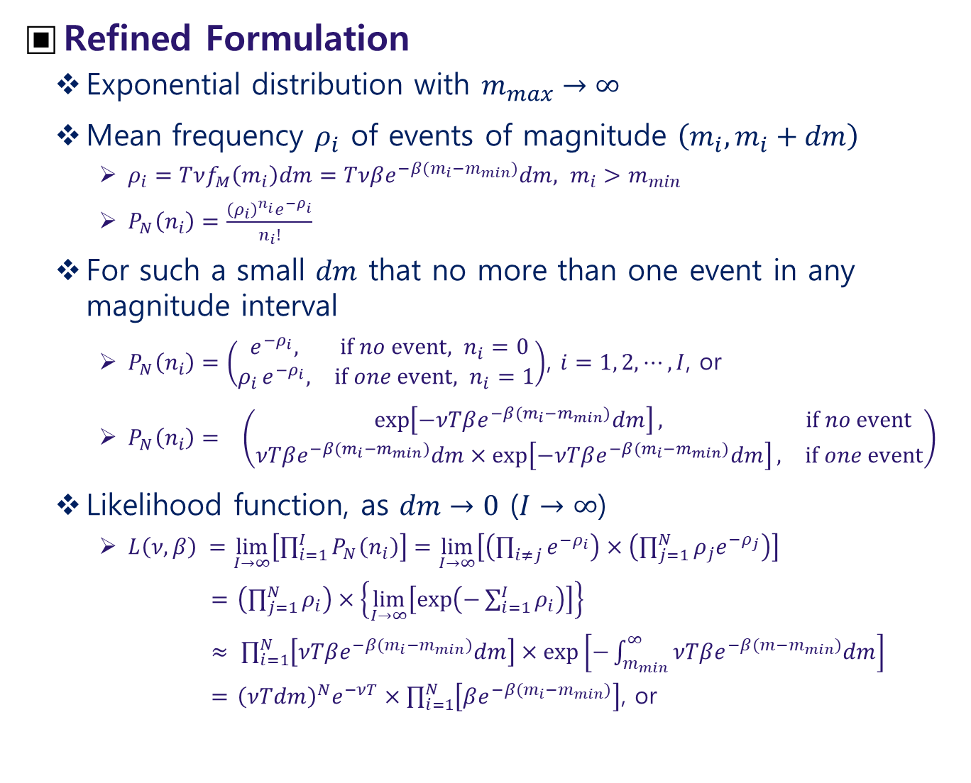
Refined Formulation
Exponential distribution with $m_{max}→∞$
Mean frequency $ρ_{i}$ of events of magnitude $\left(m_{i}, m_{i}+dm\right)$
$ρ_{i}=Tνf_{M}\left(m_{i}\right)dm=Tνβe^{−β(m_{i}−m_{min})}dm, m_{i}>m_{min}$
$P_{N}\left(n_{i}\right)=\frac{{\left(ρ_{i}\right)}^{n_{i}}e^{−ρ_{i}}}{n_{i}!}$
For such a small $dm$ that no more than one event in any magnitude interval
$P_{N}\left(n_{i}\right)=\left(\begin{matrix}e^{−ρ_{i}}, & if no event, n_{i}=0 \\ {ρ_{i }e}^{−ρ_{i}}, & if one event, n_{i}=1\end{matrix}\right)$, $i=1, 2, ⋯, I$, or
$P_{N}\left(n_{i}\right)= \left(\begin{matrix}\exp\left[−νTβe^{−β(m_{i}−m_{min})}dm\right], & if no event \\ νTβe^{−β(m_{i}−m_{min})}dm×exp\left[−νTβe^{−β(m_{i}−m_{min})}dm\right], & if one event\end{matrix}\right)$
Likelihood function, as $dm→0$ ($I→∞$)
$L\left(ν,β\right) =\lim_{I→∞}\left[\prod_{i=1}^{I}{P_{N}\left(n_{i}\right)}\right]=\lim_{I→∞}\left[\left(\prod_{i≠j}{e^{−ρ_{i}}}\right)×\left(\prod_{j=1}^{N}{{ρ_{j}e}^{−ρ_{j}}}\right)\right]$
$\left(\prod_{j=1}^{N}{ρ_{i}}\right)×\left\{\lim_{I→∞}\left[\exp\left(−\sum_{i=1}^{I}{ρ_{i}}\right)\right]\right\}$
$\prod_{i=1}^{N}{\left[νTβe^{−β(m_{i}−m_{min})}dm\right]×\exp\left[−\int_{m_{min}}^{∞}{νTβe^{−β(m−m_{min})}dm}\right]}$
${\left(νTdm\right)}^{N}e^{−νT}×\prod_{i=1}^{N}{\left[βe^{−β(m_{i}−m_{min})}\right]}$, or

Slide 27
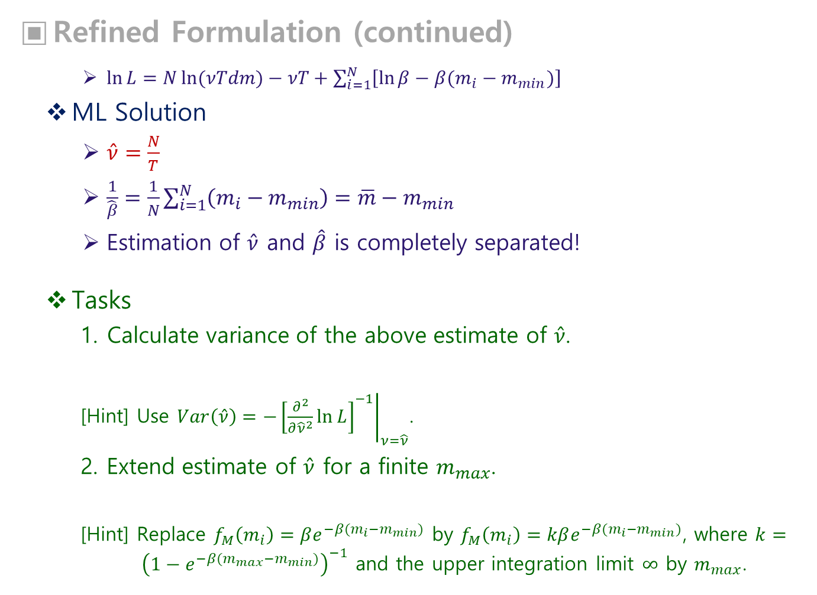
Refined Formulation (continued)
$\ln{L}=N\ln{(νTdm)}−νT+\sum_{i=1}^{N}{\left[\ln{β}−β(m_{i}−m_{min})\right]}$
ML Solution
$\hat{ν}=\frac{N}{T}$
$\frac{1}{\hat{β}}=\frac{1}{N}\sum_{i=1}^{N}{\left(m_{i}−m_{min}\right)}=\overline{m}−m_{min}$
Estimation of $\hat{ν}$ and $\hat{β}$ is completely separated!
Tasks
Calculate variance of the above estimate of $\hat{ν}$.
[Hint] Use $Var\left(\hat{ν}\right)=−{\left.{\left[\frac{∂^{2}}{∂{\hat{ν}}^{2}}\ln{L}\right]}^{−1}\right|}_{ν=\hat{ν}}$.
Extend estimate of $\hat{ν}$ for a finite $m_{max}$.
[Hint] Replace $f_{M}\left(m_{i}\right)=βe^{−β(m_{i}−m_{min})}$ by $f_{M}\left(m_{i}\right)=kβe^{−β(m_{i}−m_{min})}$, where $k={\left(1−e^{−β(m_{max}−m_{min})}\right)}^{−1}$ and the upper integration limit $∞$ by $m_{max}$.

Slide 28
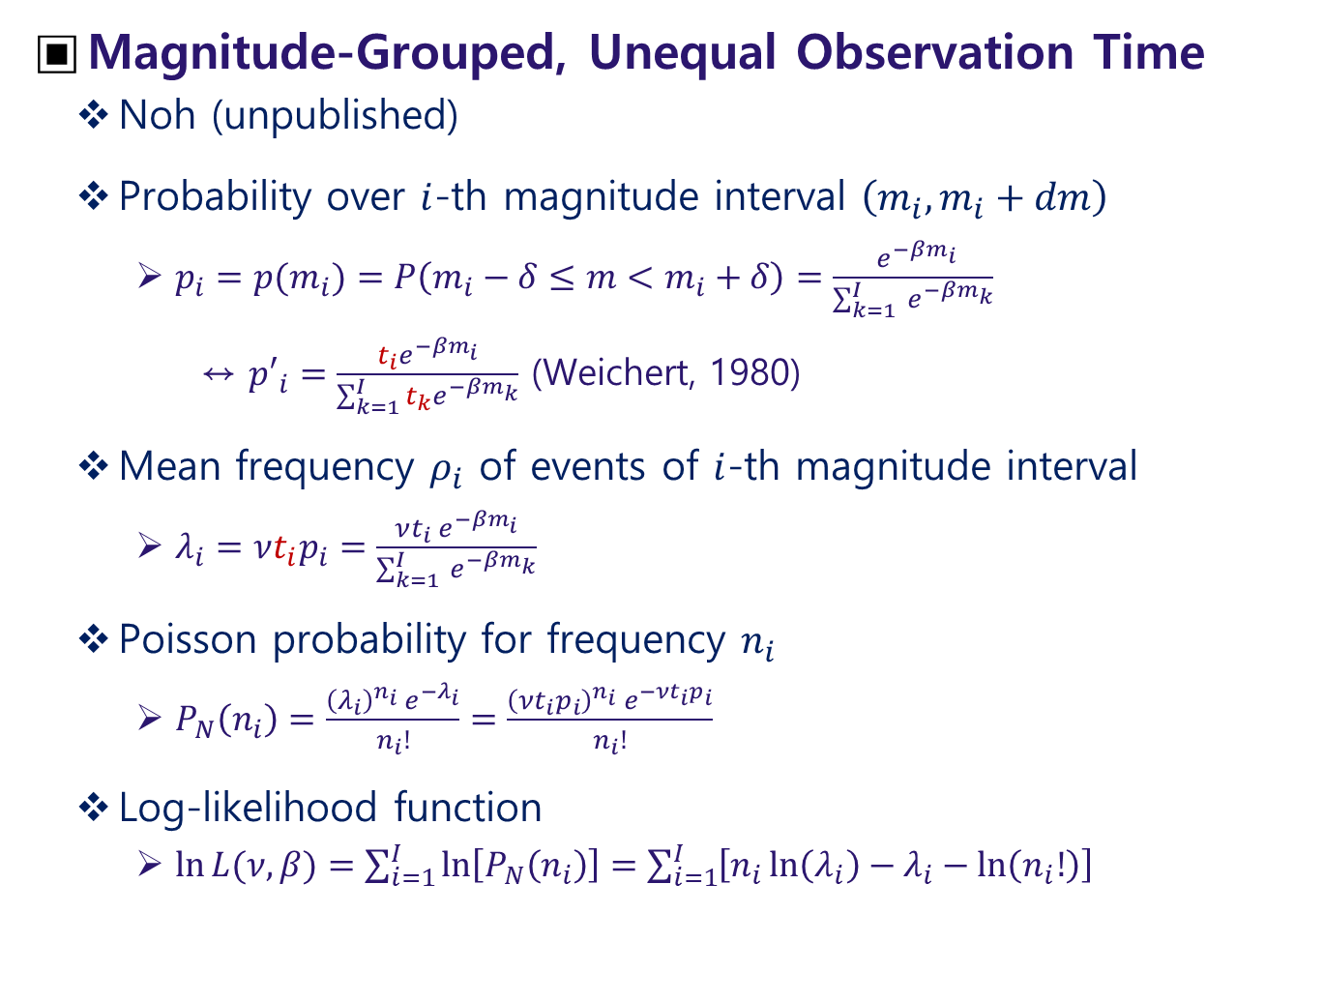
Magnitude-Grouped, Unequal Observation Time
Noh (unpublished)
Probability over $i$-th magnitude interval $\left(m_{i}, m_{i}+dm\right)$
$p_{i}={p(m}_{i})=P\left(m_{i}−δ≤m<m_{i}+δ\right)=\frac{ e^{−βm_{i}}}{\sum_{k=1}^{I}{ e^{−βm_{k}}}}$
↔ ${p′}_{i}=\frac{t_{i}e^{−βm_{i}}}{\sum_{k=1}^{I}{t_{k}e^{−βm_{k}}}}$ (Weichert, 1980)
Mean frequency $ρ_{i}$ of events of $i$-th magnitude interval
$λ_{i}=νt_{i}p_{i}=\frac{νt_{i} e^{−βm_{i}}}{\sum_{k=1}^{I}{ e^{−βm_{k}}}}$
Poisson probability for frequency $n_{i}$
$P_{N}\left(n_{i}\right)=\frac{{\left(λ_{i}\right)}^{n_{i}}{ e}^{{−λ}_{i}}}{n_{i}!}=\frac{{\left(νt_{i}p_{i}\right)}^{n_{i}}{ e}^{−νt_{i}p_{i}}}{n_{i}!}$
Log-likelihood function
$\ln{L(ν,β)}=\sum_{i=1}^{I}{\ln\left[P_{N}\left(n_{i}\right)\right]}=\sum_{i=1}^{I}{\left[n_{i}\ln\left(λ_{i}\right)−λ_{i}−\ln\left(n_{i}!\right)\right]}$

Slide 29
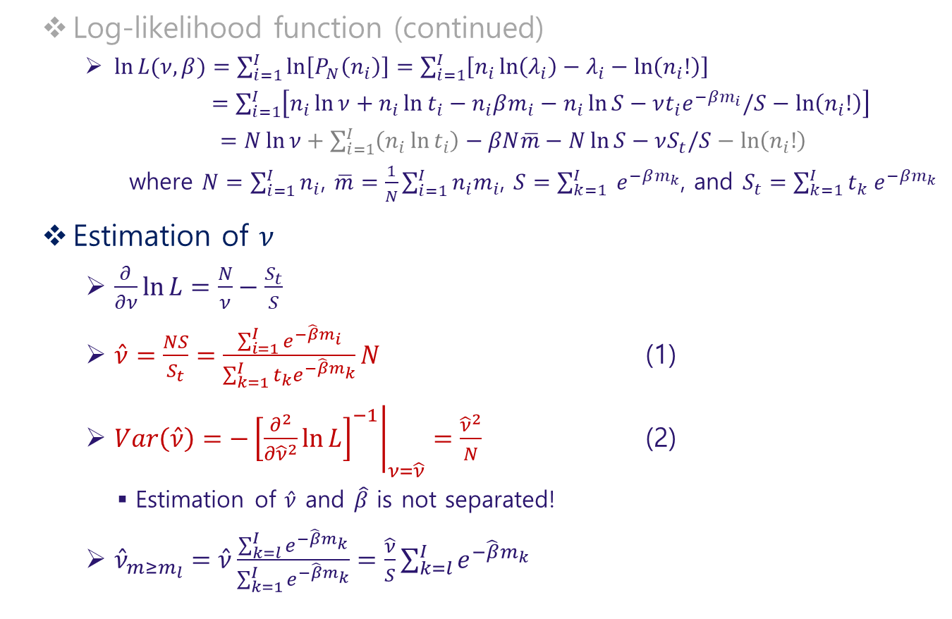
Log-likelihood function (continued)
$\ln{L(ν,β)}=\sum_{i=1}^{I}{\ln\left[P_{N}\left(n_{i}\right)\right]}=\sum_{i=1}^{I}{\left[n_{i}\ln\left(λ_{i}\right)−λ_{i}−\ln\left(n_{i}!\right)\right]}$
$=\sum_{i=1}^{I}{\left[n_{i}\ln{ν}+n_{i}\ln{t_{i}}−n_{i}βm_{i}−n_{i}\ln{S}−νt_{i}e^{−βm_{i}}/S−\ln\left(n_{i}!\right)\right]}$
$=N\ln{ν}+\sum_{i=1}^{I}{\left(n_{i}\ln{t_{i}}\right)}−βN\overline{m}−N\ln{S}−νS_{t}/S−\ln\left(n_{i}!\right)$
where $N=\sum_{i=1}^{I}{n_{i}}$, $\overline{m}=\frac{1}{N}\sum_{i=1}^{I}{n_{i}m_{i}}$, $S=\sum_{k=1}^{I}{ e^{−βm_{k}}}$, and $S_{t}=\sum_{k=1}^{I}{t_{k} e^{−βm_{k}}}$
Estimation of $ν$
$\frac{∂}{∂ν}\ln{L}=\frac{N}{ν}−\frac{S_{t}}{S}$
$\hat{ν}=\frac{NS}{S_{t}}=\frac{\sum_{i=1}^{I}{e^{−\hat{β}m_{i}}}}{\sum_{k=1}^{I}{t_{k}e^{−\hat{β}m_{k}}}}N$ (1)
$Var\left(\hat{ν}\right)=−{\left.{\left[\frac{∂^{2}}{∂{\hat{ν}}^{2}}\ln{L}\right]}^{−1}\right|}_{ν=\hat{ν}}=\frac{{\hat{ν}}^{2}}{N}$ (2)
Estimation of $\hat{ν}$ and $\hat{β}$ is not separated!
${\hat{ν}}_{m≥m_{l}}=\hat{ν}\frac{\sum_{k=l}^{I}{e^{−\hat{β}m_{k}}}}{\sum_{k=1}^{I}{e^{−\hat{β}m_{k}}}}=\frac{\hat{ν}}{S}\sum_{k=l}^{I}{e^{−\hat{β}m_{k}}}$

Slide 30
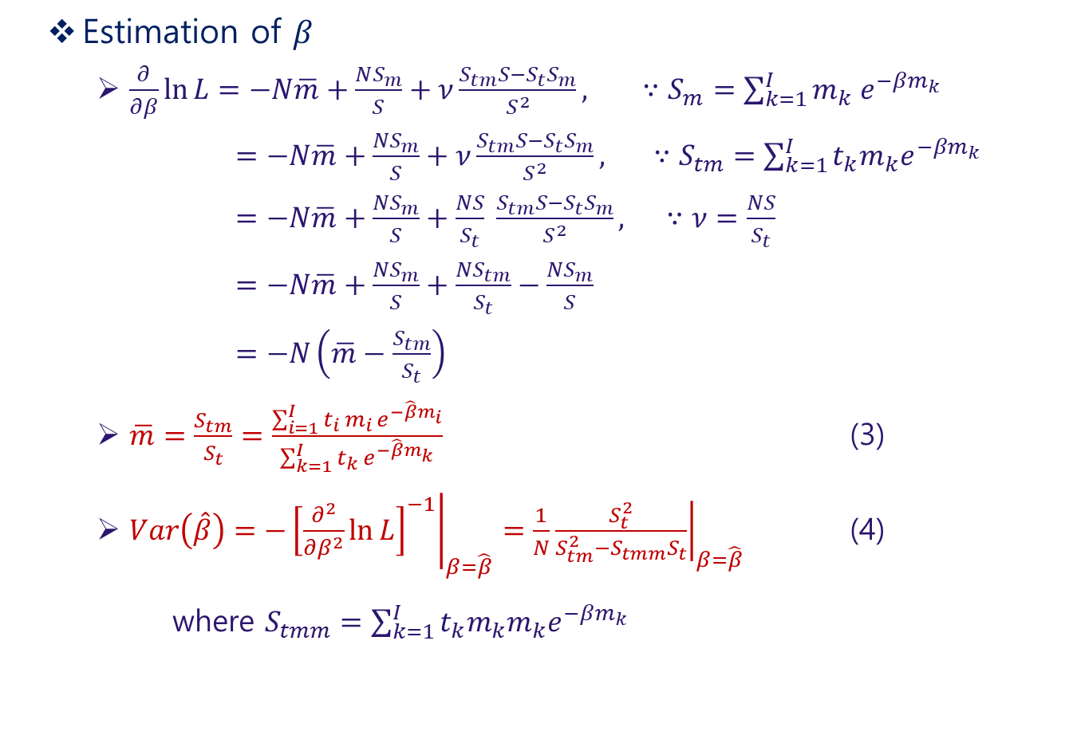
Estimation of $β$
$\frac{∂}{∂β}\ln{L}=−N\overline{m}+\frac{NS_{m}}{S}+ν\frac{S_{tm}S−S_{t}S_{m}}{S^{2}}, ∵S_{m}=\sum_{k=1}^{I}{m_{k} e^{−βm_{k}}}$
$=−N\overline{m}+\frac{NS_{m}}{S}+ν\frac{S_{tm}S−S_{t}S_{m}}{S^{2}}, ∵S_{tm}=\sum_{k=1}^{I}{t_{k}m_{k}e^{−βm_{k}}}$
$=−N\overline{m}+\frac{NS_{m}}{S}+\frac{NS}{S_{t}} \frac{S_{tm}S−S_{t}S_{m}}{S^{2}}, ∵ν=\frac{NS}{S_{t}}$
$=−N\overline{m}+\frac{NS_{m}}{S}+\frac{NS_{tm}}{S_{t}}−\frac{NS_{m}}{S}$
$=−N\left(\overline{m}−\frac{S_{tm}}{S_{t}}\right)$
$\overline{m}=\frac{S_{tm}}{S_{t}}=\frac{\sum_{i=1}^{I}{{t_{i }m_{i }e}^{−\hat{β}m_{i}}}}{\sum_{k=1}^{I}{t_{k }e^{−\hat{β}m_{k}}}}$ (3)
$Var\left(\hat{β}\right)=−{\left.{\left[\frac{∂^{2}}{∂β^{2}}\ln{L}\right]}^{−1}\right|}_{β=\hat{β}}=\frac{1}{N}{\left.\frac{S_{t}^{2}}{S_{tm}^{2}−S_{tmm}S_{t}}\right|}_{β=\hat{β}}$ (4)
where $S_{tmm}=\sum_{k=1}^{I}{t_{k}m_{k}m_{k}e^{−βm_{k}}}$

Slide 31

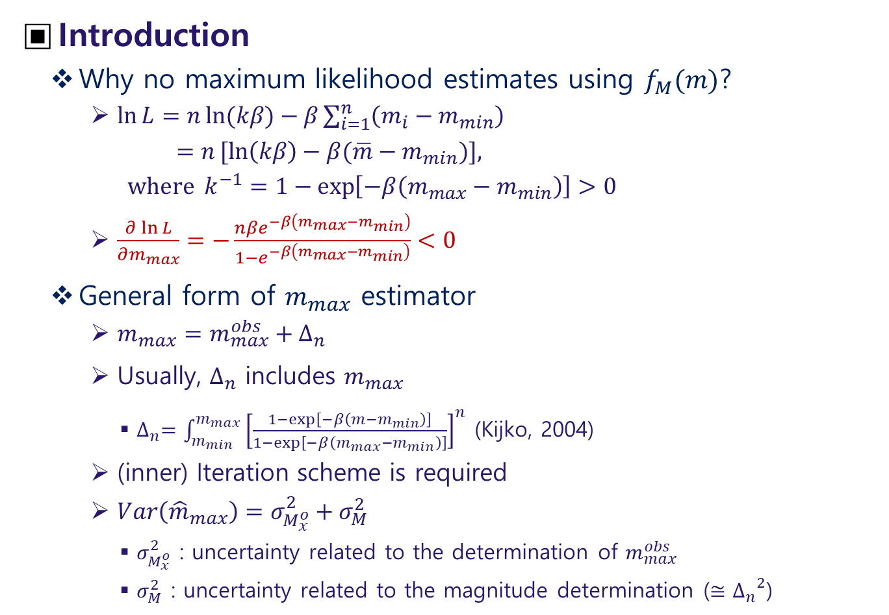
Estimation of $m_{max}$
Introduction
Why no maximum likelihood estimates using $f_{M}(m)$?
$\ln{L}=n\ln{(kβ)}−β\sum_{i=1}^{n}{\left(m_{i}−m_{min}\right)}$
$=n[ln\left(kβ\right)−β(\overline{m}−m_{min})]$,
where $k^{−1}=1−\exp\left[−β\left(m_{max}−m_{min}\right)\right]>0$
$\frac{∂\ln{L}}{∂m_{max}}=−\frac{nβe^{−β\left(m_{max}−m_{min}\right)}}{1−e^{−β\left(m_{max}−m_{min}\right)}}<0$
General form of $m_{max}$ estimator
$m_{max}=m_{max}^{obs}+∆_{n}$
Usually, $∆_{n}$ includes $m_{max}$
$∆_{n}=\int_{m_{min}}^{m_{max}}{{\left[\frac{1−\exp\left[−β\left(m−m_{min}\right)\right]}{1−\exp\left[−β\left(m_{max}−m_{min}\right)\right]}\right]}^{n}}$ (Kijko, 2004)
(inner) Iteration scheme is required
$Var\left({\hat{m}}_{max}\right)=σ_{M_{x}^{o}}^{2}+σ_{M}^{2}$
$σ_{M_{x}^{o}}^{2}$ : uncertainty related to the determination of $m_{max}^{obs}$
$σ_{M}^{2}$ : uncertainty related to the magnitude determination ($≅{∆_{n}}^{2}$)

Slide 32
List of Methods
Class | Name | Remark
Parametric | T-P | Procedure by Pisarenko et al. (1996)
 | K-S | Procedure by Kijko & Sellevoll (1989)
 | T-P-B | Tate-Pisarenko-Bayes procedure
 | K-S-B | Kijko-Sellevoll-Bayes procedure
Non-parametric | N-P-G | Non-parametric procedure with Gaussian kernel
 | N-P-OS | Non-parametric procedure based on order statistics
 | R-W | Robson-Whitlock procedure
 | R-W-C | Robson-Whitlock-Cooke procedure
 | F-L-E | Procedure based on a few large earthquakes
Fit of CDF | L1-Fit | Procedure based on fit of L1 norm CDF
 | L2-Fit | Procedure based on fit of L2 norm CDF

Slide 33
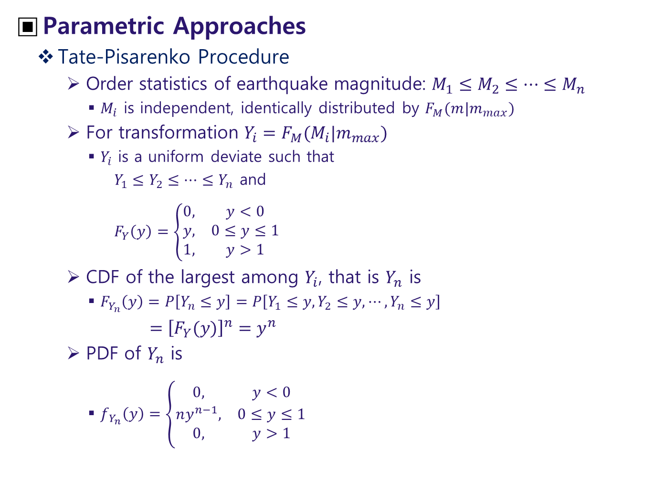
Parametric Approaches
Tate-Pisarenko Procedure
Order statistics of earthquake magnitude: $M_{1}≤M_{2}≤⋯≤M_{n}$
$M_{i}$ is independent, identically distributed by $F_{M}(m|m_{max})$
For transformation $Y_{i}=F_{M}(M_{i}|m_{max})$
$Y_{i}$ is a uniform deviate such that
$Y_{1}≤Y_{2}≤⋯≤Y_{n}$ and
$F_{Y}\left(y\right)=\left\{\begin{matrix}0, & y<0 \\ y, & 0≤y≤1 \\ 1, & y>1\end{matrix}\right.$
CDF of the largest among $Y_{i}$, that is $Y_{n}$ is
$F_{Y_{n}}\left(y\right)=P\left[Y_{n}≤y\right]=P\left[Y_{1}≤y,Y_{2}≤y,⋯,Y_{n}≤y\right]$
$={\left[F_{Y}(y)\right]}^{n}=y^{n}$
PDF of $Y_{n}$ is
$f_{ Y_{n}}\left(y\right)=\left\{\begin{matrix}0, & y<0 \\ ny^{n−1}, & 0≤y≤1 \\ 0, & y>1\end{matrix}\right.$

Slide 34
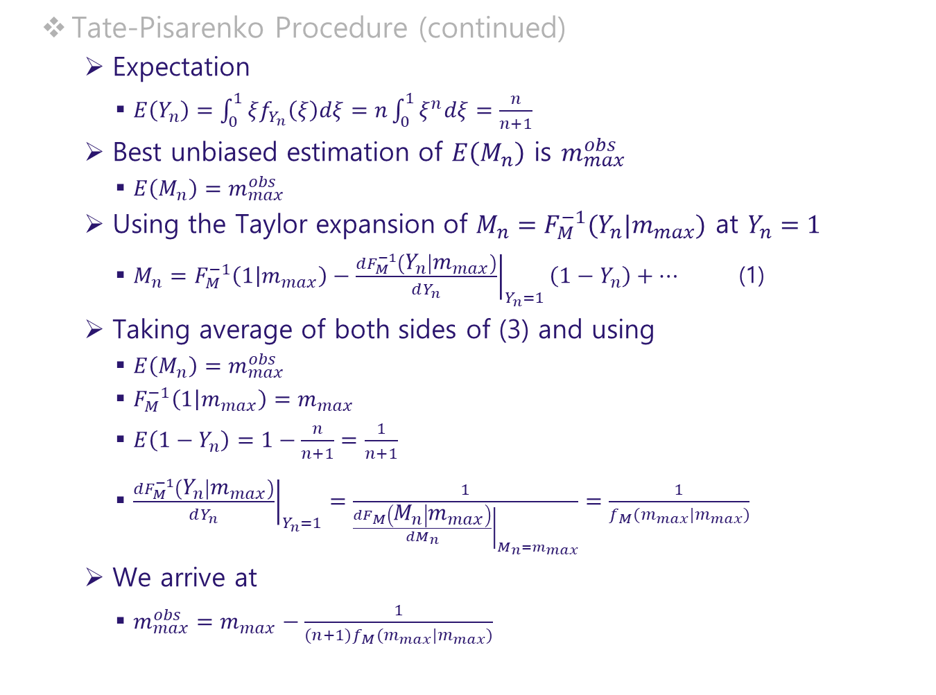
Tate-Pisarenko Procedure (continued)
Expectation
$E\left(Y_{n}\right)=\int_{0}^{1}{ξf_{Y_{n}}\left(ξ\right)dξ}=n\int_{0}^{1}{ξ^{n}dξ}=\frac{n}{n+1}$
Best unbiased estimation of $E\left(M_{n}\right)$ is $m_{max}^{obs}$
$E\left(M_{n}\right)=m_{max}^{obs}$
Using the Taylor expansion of $M_{n}=F_{M}^{−1}(Y_{n}|m_{max})$ at $Y_{n}=1$
$M_{n}=F_{M}^{−1}\left(1 | m_{max}\right)−{\left.\frac{dF_{M}^{−1}\left(Y_{n} | m_{max}\right)}{dY_{n}}\right|}_{Y_{n}=1}\left(1−Y_{n}\right)+⋯$ (1)
Taking average of both sides of (3) and using
$E\left(M_{n}\right)=m_{max}^{obs}$
$F_{M}^{−1}\left(1 | m_{max}\right)=m_{max}$
$E\left(1−Y_{n}\right)=1−\frac{n}{n+1}=\frac{1}{n+1}$
${\left.\frac{dF_{M}^{−1}\left(Y_{n} | m_{max}\right)}{dY_{n}}\right|}_{Y_{n}=1}=\frac{1}{{\left.\frac{dF_{M}\left(M_{n} | m_{max}\right)}{dM_{n}}\right|}_{M_{n}=m_{max}}}=\frac{1}{f_{M}(m_{max}|m_{max})}$
We arrive at
$m_{max}^{obs}=m_{max}−\frac{1}{(n+1)f_{M}(m_{max}|m_{max})}$

Slide 35
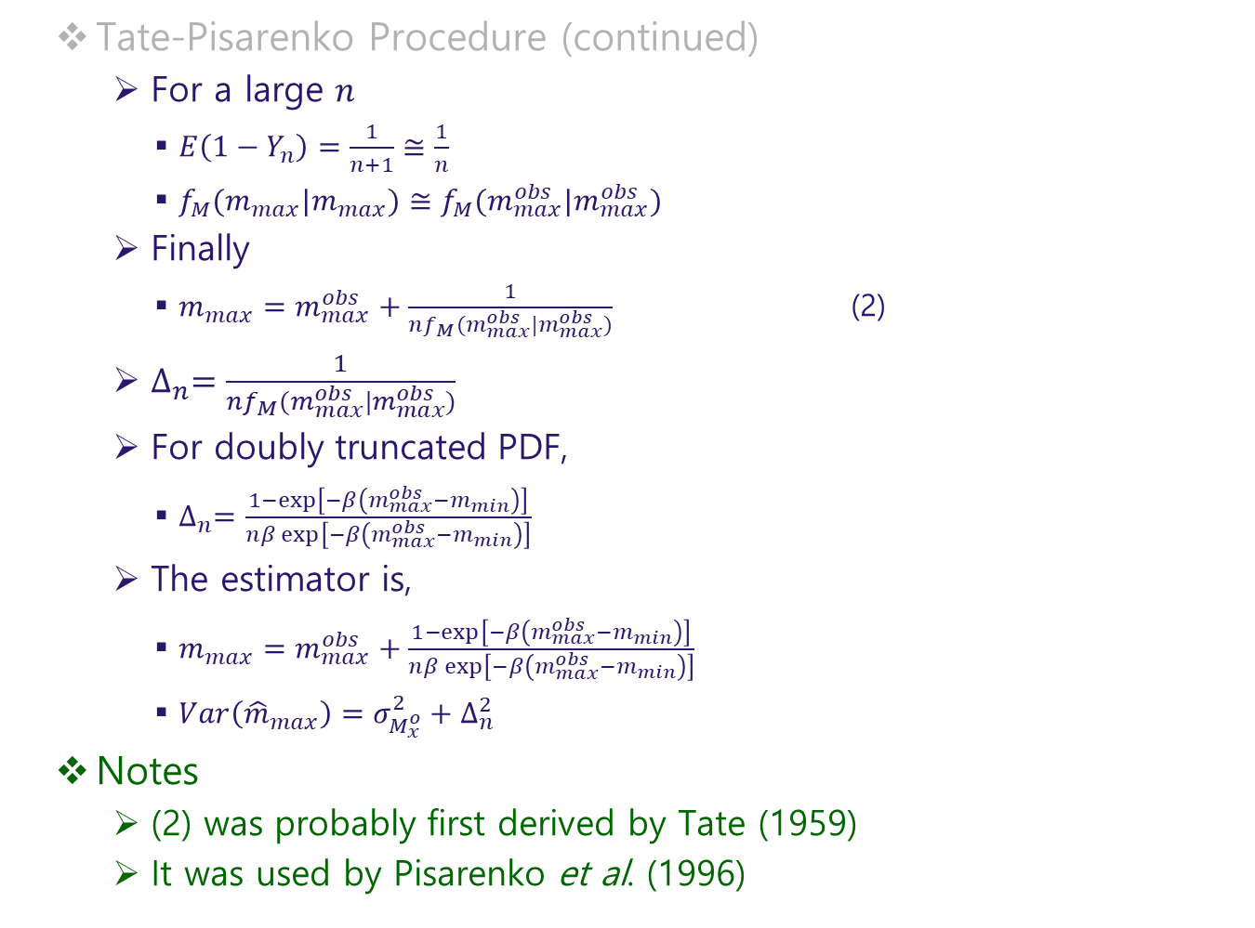
Tate-Pisarenko Procedure (continued)
For a large $n$
$E\left(1−Y_{n}\right)=\frac{1}{n+1}≅\frac{1}{n}$
$f_{M}(m_{max}|m_{max})≅f_{M}(m_{max}^{obs}|m_{max}^{obs})$
Finally
$m_{max}=m_{max}^{obs}+\frac{1}{nf_{M}(m_{max}^{obs}|m_{max}^{obs})}$ (2)
$∆_{n}=\frac{1}{nf_{M}(m_{max}^{obs}|m_{max}^{obs})}$
For doubly truncated PDF,
$∆_{n}=\frac{1−\exp\left[−β\left(m_{max}^{obs}−m_{min}\right)\right]}{nβ\exp\left[−β\left(m_{max}^{obs}−m_{min}\right)\right]}$
The estimator is,
$m_{max}=m_{max}^{obs}+\frac{1−\exp\left[−β\left(m_{max}^{obs}−m_{min}\right)\right]}{nβ\exp\left[−β\left(m_{max}^{obs}−m_{min}\right)\right]}$
$Var\left({\hat{m}}_{max}\right)=σ_{M_{x}^{o}}^{2}+∆_{n}^{2}$
Notes
(2) was probably first derived by Tate (1959)
It was used by Pisarenko et al. (1996)

Slide 36
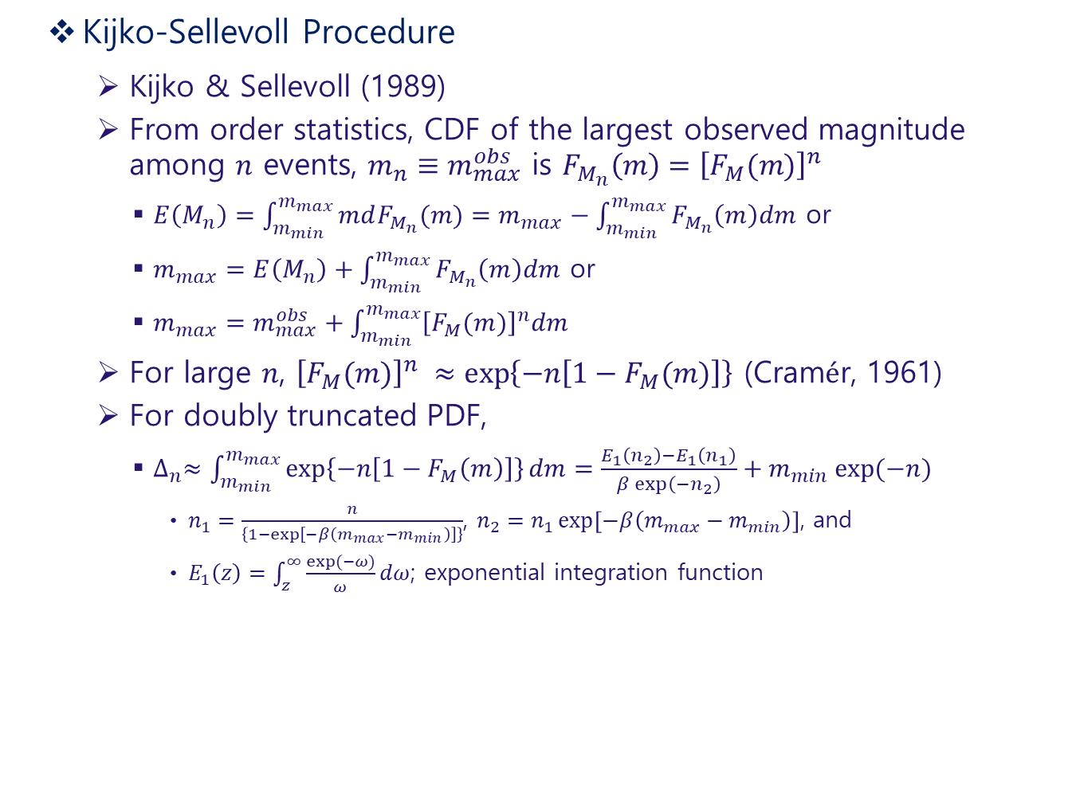
Kijko-Sellevoll Procedure
Kijko & Sellevoll (1989)
From order statistics, CDF of the largest observed magnitude among $n$ events, $m_{n}≡m_{max}^{obs}$ is $F_{M_{n}}\left(m\right)={\left[F_{M}(m)\right]}^{n}$
$E\left(M_{n}\right)=\int_{m_{min}}^{m_{max}}{mdF_{M_{n}}(m)}=m_{max}−\int_{m_{min}}^{m_{max}}{F_{M_{n}}\left(m\right)dm}$ or
$m_{max}=E\left(M_{n}\right)+\int_{m_{min}}^{m_{max}}{F_{M_{n}}\left(m\right)dm}$ or
$m_{max}=m_{max}^{obs}+\int_{m_{min}}^{m_{max}}{{\left[F_{M}(m)\right]}^{n}dm}$
For large $n$, ${\left[F_{M}(m)\right]}^{n} ≈\exp\left\{−n\left[1−F_{M}(m)\right]\right\}$ (Cramér, 1961)
For doubly truncated PDF,
$∆_{n}≈\int_{m_{min}}^{m_{max}}{\exp\left\{−n\left[1−F_{M}\left(m\right)\right]\right\}dm}=\frac{E_{1}\left(n_{2}\right)−E_{1}\left(n_{1}\right)}{β\exp\left(−n_{2}\right)}+m_{min}\exp{(−n)}$
$n_{1}=\frac{n}{\left\{1−\exp\left[−β\left(m_{max}−m_{min}\right)\right]\right\}}$, $n_{2}=n_{1}\exp\left[−β\left(m_{max}−m_{min}\right)\right]$, and
$E_{1}\left(z\right)=\int_{z}^{∞}{\frac{\exp{(−ω)}}{ω}dω}$; exponential integration function

Slide 37
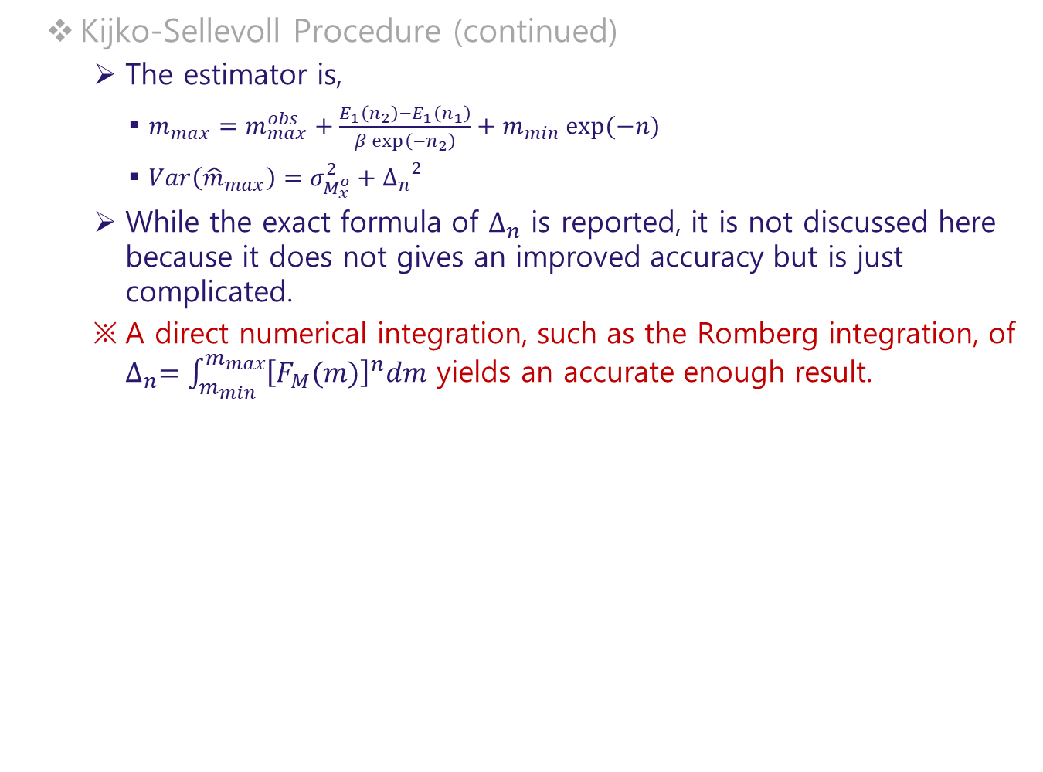
Kijko-Sellevoll Procedure (continued)
The estimator is,
$m_{max}=m_{max}^{obs}+\frac{E_{1}\left(n_{2}\right)−E_{1}\left(n_{1}\right)}{β\exp\left(−n_{2}\right)}+m_{min}\exp{(−n)}$
$Var\left({\hat{m}}_{max}\right)=σ_{M_{x}^{o}}^{2}+{∆_{n}}^{2}$
While the exact formula of $∆_{n}$ is reported, it is not discussed here because it does not gives an improved accuracy but is just complicated.
A direct numerical integration, such as the Romberg integration, of $∆_{n}=\int_{m_{min}}^{m_{max}}{{\left[F_{M}(m)\right]}^{n}dm}$ yields an accurate enough result.

Slide 38
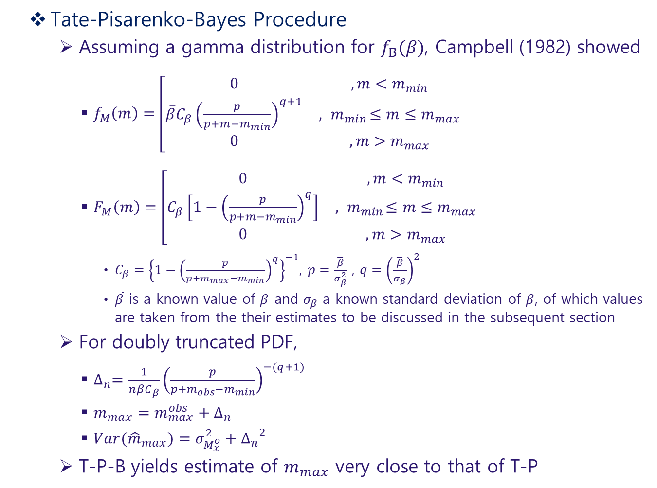
Tate-Pisarenko-Bayes Procedure
Assuming a gamma distribution for $f_{Β}(β)$, Campbell (1982) showed
$f_{M}\left(m\right)=\left[\begin{matrix}0 & , m<m_{min} \\ \overline{β}C_{β}{\left(\frac{p}{p+m−m_{min}}\right)}^{q+1} & ,{ m}_{min}≤m≤m_{max} \\ 0 & , m>m_{max}\end{matrix}\right.$
$F_{M}\left(m\right)=\left[\begin{matrix}0 & , m<m_{min} \\ C_{β}\left[1−{\left(\frac{p}{p+m−m_{min}}\right)}^{q}\right] & ,{ m}_{min}≤m≤m_{max} \\ 0 & , m>m_{max}\end{matrix}\right.$
$C_{β}={\left\{1−{\left(\frac{p}{p+m_{max}−m_{min}}\right)}^{q}\right\}}^{−1}$, $p=\frac{\overline{β}}{σ_{β}^{2}}$ , $q={\left(\frac{\overline{β}}{σ_{β}}\right)}^{2}$
$\overline{β}$ is a known value of $β$ and $σ_{β}$ a known standard deviation of $β$, of which values are taken from the their estimates to be discussed in the subsequent section
For doubly truncated PDF,
$∆_{n}=\frac{1}{n\overline{β}C_{β}}{\left(\frac{p}{p+m_{obs}−m_{min}}\right)}^{−(q+1)}$
$m_{max}=m_{max}^{obs}+∆_{n}$
$Var({\hat{m}}_{max})=σ_{M_{x}^{o}}^{2}+{∆_{n}}^{2}$
T-P-B yields estimate of $m_{max}$ very close to that of T-P

Slide 39
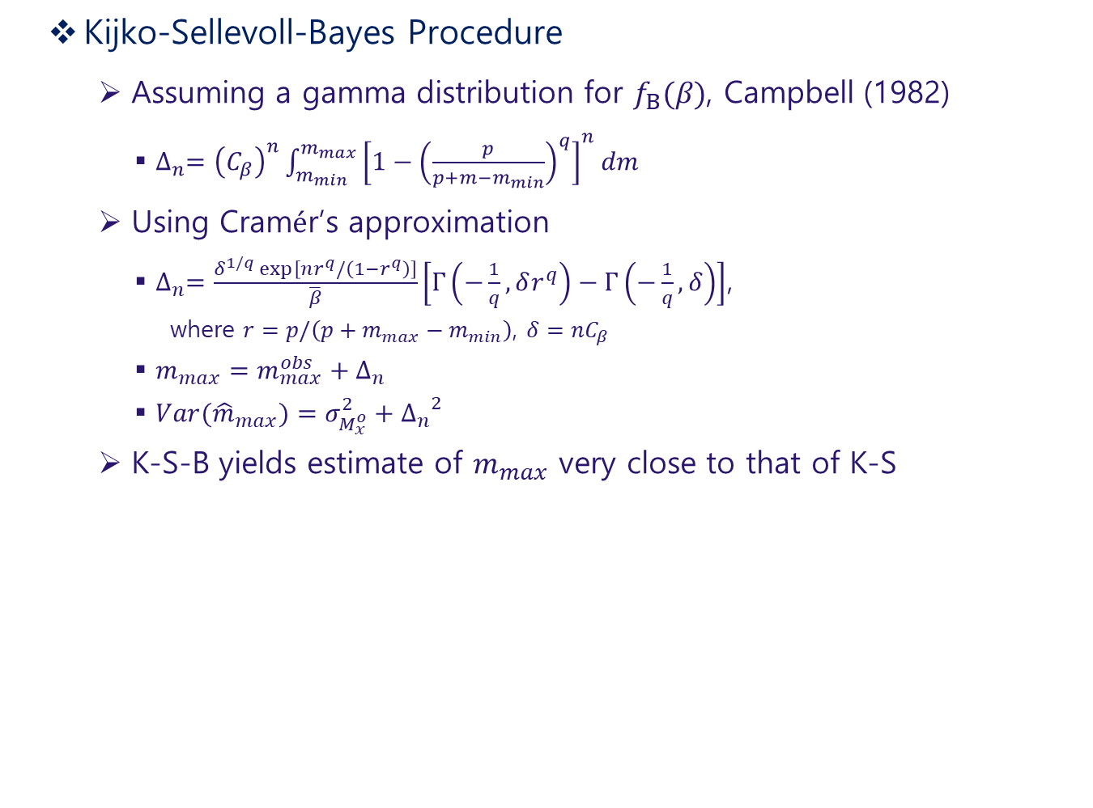
Kijko-Sellevoll-Bayes Procedure
Assuming a gamma distribution for $f_{Β}(β)$, Campbell (1982)
$∆_{n}={\left(C_{β}\right)}^{n}\int_{m_{min}}^{m_{max}}{{\left[1−{\left(\frac{p}{p+m−m_{min}}\right)}^{q}\right]}^{n}dm}$
Using Cramér’s approximation
$∆_{n}=\frac{δ^{1/q}\exp\left[nr^{q}/\left(1−r^{q}\right)\right]}{\overline{β}}\left[Γ\left(−\frac{1}{q},δr^{q}\right)−Γ\left(−\frac{1}{q},δ\right)\right]$,
where $r=p/\left(p+m_{max}−m_{min}\right)$, $δ=nC_{β}$
$m_{max}=m_{max}^{obs}+∆_{n}$
$Var({\hat{m}}_{max})=σ_{M_{x}^{o}}^{2}+{∆_{n}}^{2}$
K-S-B yields estimate of $m_{max}$ very close to that of K-S

Slide 40
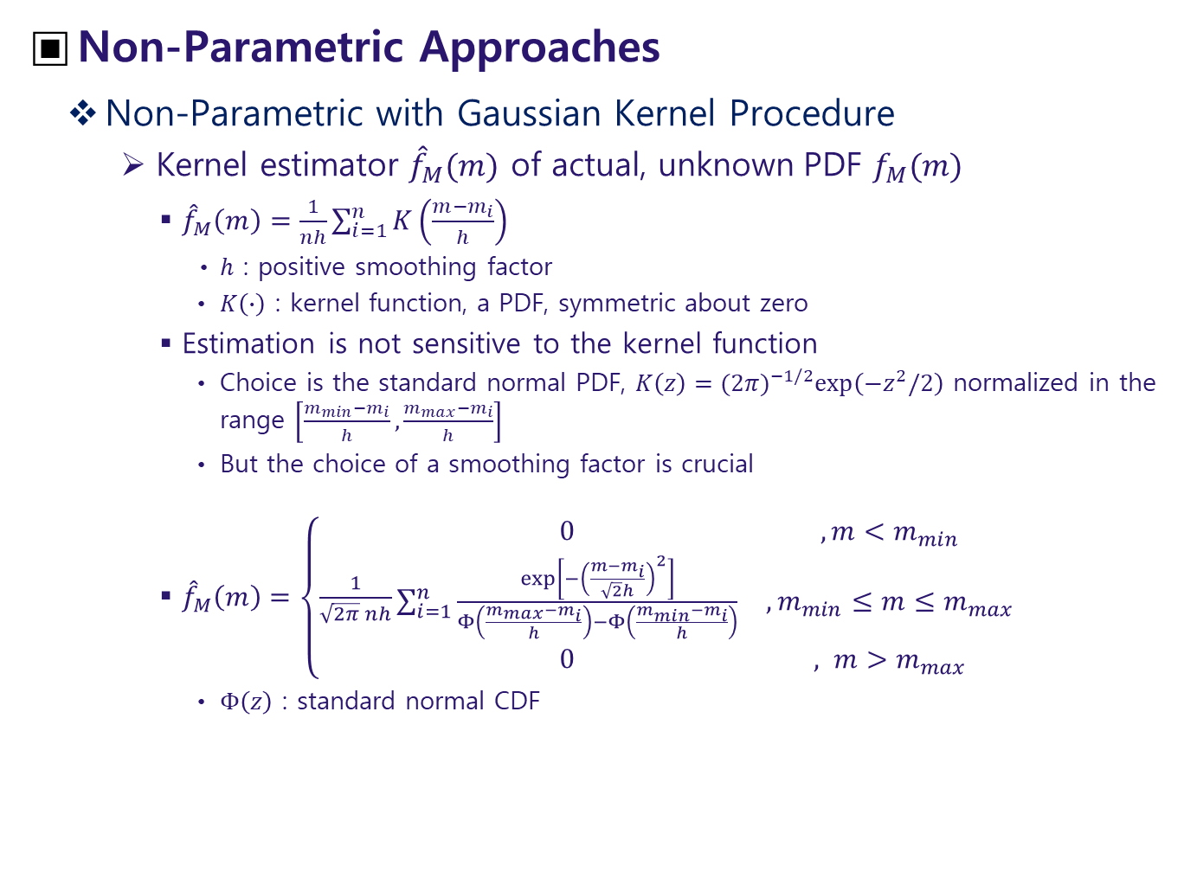
Non-Parametric Approaches
Non-Parametric with Gaussian Kernel Procedure
Kernel estimator ${\hat{f}}_{M}(m)$ of actual, unknown PDF $f_{M}(m)$
${\hat{f}}_{M}\left(m\right)=\frac{1}{nh}\sum_{i=1}^{n}{K\left(\frac{m−m_{i}}{h}\right)}$
$h$ : positive smoothing factor
$K\left(∙\right)$ : kernel function, a PDF, symmetric about zero
Estimation is not sensitive to the kernel function
Choice is the standard normal PDF, $K\left(z\right)={(2π)}^{−1/2}\exp\left(−z^{2}/2\right)$ normalized in the range $\left[\frac{m_{min}−m_{i}}{h},\frac{m_{max}−m_{i}}{h}\right]$
But the choice of a smoothing factor is crucial
${\hat{f}}_{M}\left(m\right)=\left\{\frac{1}{\sqrt{2π} nh}\begin{matrix}0 & , m<m_{min} \\ \sum_{i=1}^{n}{\frac{\exp\left[−{\left(\frac{m−m_{i}}{\sqrt{2}h}\right)}^{2}\right]}{Φ\left(\frac{m_{max}−m_{i}}{h}\right)−Φ\left(\frac{m_{min}−m_{i}}{h}\right)}} & , m_{min}{≤m≤m}_{max} \\ 0 & , m>m_{max}\end{matrix}\right.$
$Φ\left(z\right)$ : standard normal CDF

Slide 41
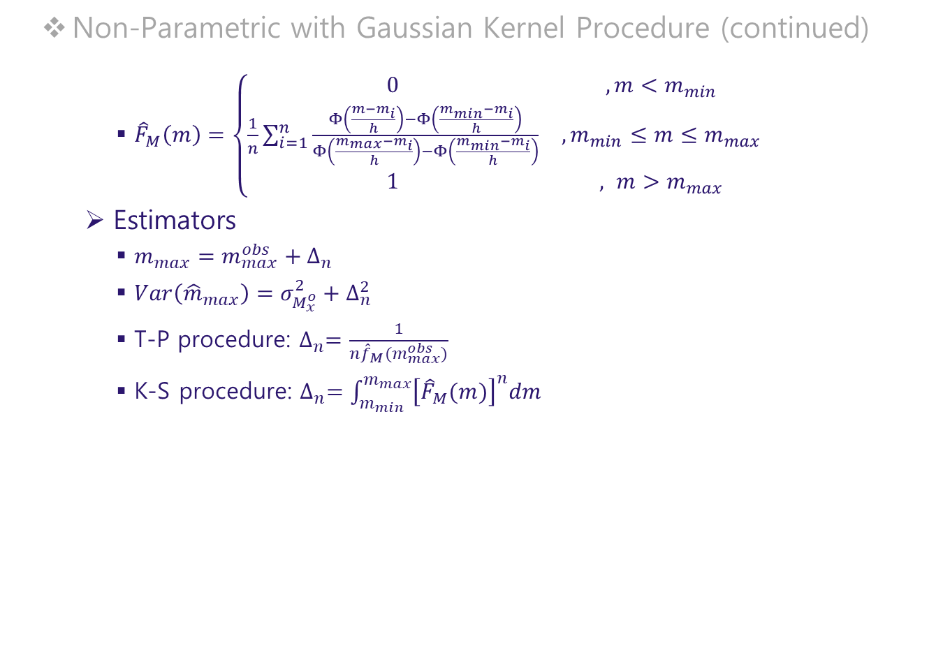
Non-Parametric with Gaussian Kernel Procedure (continued)
${\hat{F}}_{M}\left(m\right)=\left\{\begin{matrix}0 & , m<m_{min} \\ \frac{1}{n}\sum_{i=1}^{n}{\frac{Φ\left(\frac{m−m_{i}}{h}\right)−Φ\left(\frac{m_{min}−m_{i}}{h}\right)}{Φ\left(\frac{m_{max}−m_{i}}{h}\right)−Φ\left(\frac{m_{min}−m_{i}}{h}\right)}} & , m_{min}{≤m≤m}_{max} \\ 1 & , m>m_{max}\end{matrix}\right.$
Estimators
$m_{max}=m_{max}^{obs}+∆_{n}$
$Var\left({\hat{m}}_{max}\right)=σ_{M_{x}^{o}}^{2}+∆_{n}^{2}$
T-P procedure: $∆_{n}=\frac{1}{n{\hat{f}}_{M}(m_{max}^{obs})}$
K-S procedure: $∆_{n}=\int_{m_{min}}^{m_{max}}{{\left[{\hat{F}}_{M}(m)\right]}^{n}dm}$

Slide 42

Non-Parametric Procedure Based on Order Statistics
For ordered $n$ observations, $m_{1}≤m_{2}≤⋯≤m_{n−1}≤m_{n}$
${\hat{F}}_{M}\left(m\right)=\left\{\begin{matrix}0 & , m<m_{1} \\ \frac{i}{n} & , m_{i}{≤m≤m}_{i+1} \\ 1 & , m>m_{n}\end{matrix}\right.$ (Cooke, 1979)
Approximate of integral $∆_{n}$
$∆_{n}≡\int_{m_{min}}^{m_{max}^{obs}}{{\left[{\hat{F}}_{M}\left(m\right)\right]}^{n}}=\sum_{i=1}^{n−1}{{\left(\frac{1}{n}\right)}^{n}\left(m_{i+1}−m_{i}\right)}$
$=m_{max}^{obs}−\sum_{i=0}^{n−1}{\left[{\left(1−\frac{i}{n}\right)}^{n}−{\left(1−\frac{i+1}{n}\right)}^{n}\right]m_{n−i}}$
For large $n$, ${\left(1+1/n\right)}^{n}≅e$
$∆_{n}≅m_{max}^{obs}−\left(1−e^{−1}\right)\sum_{i=1}^{n−1}{e^{−i}m_{n−i}}$
Estimator of $m_{max}$
$m_{max}=m_{max}^{obs}+∆_{n}$
$Var\left({\hat{m}}_{max}\right)=c_{0}σ_{M_{x}^{o}}^{2}+∆_{n}^{2}$
$c_{0}={\left(1+e^{−1}\right)}^{2}+e^{−2}(1−e^{−1})/(1+e^{−1})≅1.93$

Slide 43

Robson-Whitlock Procedure
For ordered $n$ observations, $m_{1}≤m_{2}≤⋯≤m_{n−1}≤m_{n}$, Robson and Whitlock (1964) proposed
${\hat{m}}_{max}=m_{max}^{obs}+\left(m_{max}^{obs}−m_{n−1}\right)$
For a doubly-truncated exponential distribution
$Var\left({\hat{m}}_{max}\right)=5σ_{M_{x}^{o}}^{2}+∆_{n}^{2}$, $∆_{n}=$ $m_{max}^{obs}−m_{n−1}$
While its simplicity makes it very attractive, it is known that reduction of bias is achieved at the expense of mean squared error.

Slide 44

Robson-Whitlock-Cooke Procedure
Cooke (1979) showed that reduction of the mean squared error of the R-W estimator is possible when some information, $ν$ about the shape of the upper tail of PDF, $f_{M}(m)$
${\hat{m}}_{max}=m_{max}^{obs}+{\left(2ν\right)}^{−1}\left(m_{max}^{obs}−m_{n−1}\right)$
For a doubly-truncated exponential distribution, $ν=1$
${\hat{m}}_{max}=m_{max}^{obs}+\frac{1}{2}\left(m_{max}^{obs}−m_{n−1}\right)$
$Var\left({\hat{m}}_{max}\right)=\frac{3}{2}σ_{M_{x}^{o}}^{2}+∆_{n}^{2}$, $∆_{n}=\frac{1}{2}\left(m_{max}^{obs}−m_{n−1}\right)$

Slide 45

Procedure Based on a Few Largest Earthquakes
Gnedenko (1943) suggested for a very broad class of $F_{M}(m)$
When $m$ is near to the upper end point
$F_{M}(m)$ is linear in $m$
${\hat{m}}_{max}=\sum_{i=1}^{n_{0}}{a_{i}}m_{n−i+1}$
$a_{i}$ : coefficients to be determined, $i=1, ⋯, n_{0}$
$m_{k}$ : order statistics
$n_{0}$ : the number of largest earthquakes
For truncated distributions, the mean squared error of ${\hat{m}}_{max}$ is minimized when
$a_{2}=⋯=a_{n_{o}−1}=0$, and $a_{n_{o}}=−1/n_{0}$
That is, $∆_{n}=\frac{1}{n_{0}}\left(m_{max}^{obs}−m_{n−n_{0}+1}\right)$
Due to Quenouille (1965), an improved $∆_{n}$ is
$∆_{n}=\frac{1}{n_{0}}\left(m_{max}^{obs}−\frac{1}{n_{0}−1}\sum_{i=2}^{n_{0}}{m_{n−i+1}}\right)$

Slide 46

Procedure Based on a Few Largest Earthquakes (continued)
The estimators for $m_{max}$
${\hat{m}}_{max}=m_{max}^{obs}+∆_{n}$, $∆_{n}=\frac{1}{n_{0}}\left(m_{max}^{obs}−\frac{1}{n_{0}−1}\sum_{i=2}^{n_{0}}{m_{n−i+1}}\right)$
$Var\left({\hat{m}}_{max}\right)=c_{0}σ_{M_{x}^{o}}^{2}+∆_{n}^{2}$, $c_{0}=\left(n_{0}^{2}+n_{0}−1\right)/\left[n_{0}\left(n_{0}−1\right)\right]$
Note that
When we have sufficient sample, $n_{0}≫1$, $∆_{n}≈0$
Therefore, this estimator is useful only when we have limited information, a few large earthquakes

Slide 47

Fit of CDF Approach
Fit of CDF Approaches
Procedure Based on L1-Norm of CDF
For ordered $n$ observations, $m_{1}≤m_{2}≤⋯≤m_{n−1}≤m_{n}$, the set of model parameters $θ$ can be found by minimizing the misfit function
$J\left(θ\right)=\sum_{i=1}^{n}{\left|F_{M}\left(m_{i}\right)−{\hat{F}}_{M}(m_{i})\right|}$, ${\hat{F}}_{M}\left(m_{i}\right)=i/(n+1)$
In case of the doubly-truncated exponential PDF, $θ=\left(β, m_{max}\right)$
$θ$ can be calculated by numerical methods, such as simplex method (Press et al, 1994)
Note that, the misfit function of $L_{1}$ norm could have multiple extrema for more than one parameter

Slide 48

Procedure Based on L2-Norm of CDF
For ordered $n$ observations, $m_{1}≤m_{2}≤⋯≤m_{n−1}≤m_{n}$, the set of model parameters $θ$ can be found by minimizing the misfit function
$J\left(θ\right)=\sum_{i=1}^{n}{{\left[F_{M}\left(m_{i}\right)−{\hat{F}}_{M}(m_{i})\right]}^{2}}$, ${\hat{F}}_{M}\left(m_{i}\right)=1/(n+1)$
Solving this the least-squares method is equivalent to the maximum likelihood method with the assumption that the distribution of the CDF residuals is of Gaussian

Slide 49

Variance of $θ$ for the Gaussian Procedure
Generalized misfit function to be minimized
$J\left(θ\right)=\sum_{i=1}^{n}{{\left|q_{i}\right|}^{p}}=\sum_{i=1}^{n}{{\left|y_{i}−g_{i}(θ)\right|}^{p}}$, $p∈[1, 2)$
$y_{i}$ : $i$-th observation
$g_{i}$ : model prediction for $i$-th observation
$q_{i}$ : prediction error or noise at $i$-th observation
For the generalized Gaussian process
$f\left(q | μ,κ,β\right)=\frac{β}{2κΓ(\frac{1}{β})}\exp\left[−{\left(\frac{\left|q−μ\right|}{κ}\right)}^{β}\right]$
$μ$ : location parameter ($=0$, assuming $q_{i}$ has a zero mean)
$κ$ : scale parameter
The covariance matrix is
$C=\left\{\begin{matrix}\frac{Γ(\frac{2p−1}{β})Γ(\frac{1}{β})}{{(p−1)}^{2}Γ^{2}(\frac{p−1}{β})}κ^{2}U^{−1} & , p>1 \\ Γ^{2}(1+\frac{1}{β})κ^{2}U^{−1} & , p=1\end{matrix}\right.$, where $u_{ij}=\sum_{k=1}^{n}{g_{k,i}g_{k,j}}$ ; $g_{k,i}=\frac{∂g_{k}}{∂x_{i}}$

Slide 50

Variance of $θ$ for the Gaussian Procedure (continued)
Ordinary Gaussian process; $β=2$
$C_{G}=\left\{\begin{matrix}\frac{Γ(\frac{2p−1}{2})Γ(\frac{1}{2})}{{(p−1)}^{2}Γ^{2}(\frac{p−1}{2})}κ^{2}U^{−1} & , p>1 \\ Γ^{2}(\frac{3}{2})κ^{2}U^{−1} & , p=1\end{matrix}\right.$
$L_{1}$Norm: $p=1$
$C_{G|p=1}=Γ^{2}\left(\frac{3}{2}\right)κ^{2}U^{−1}=\frac{π}{4}κ^{2}U^{−1}$; $κ=\frac{1}{n}\sum_{i=1}^{n}{\left|q_{i}\right|} ∵ μ=0$
$L_{2}$ Norm: $p=2$
$C_{G|p=2}=\frac{1}{2}κ^{2}U^{−1}\text{ ; }κ=\sqrt{2}\sqrt{\frac{1}{n}\sum_{i=1}^{n}{{(q_{i})}^{2}}} ∵ μ=0$

Slide 51

Variance of $θ$ for the Gaussian Procedure (continued)
Finally, the matrix $U$ is calculated as follows
$q_{i}=\frac{i}{n+1}−F_{M}\left(m_{i} | β,m_{max}\right)=\frac{i}{n+1}−\frac{1−e^{−β\left(m_{i}−m_{min}\right)}}{1−e^{−β\left(m_{max}−m_{min}\right)}}$
$g_{i,1}=\frac{∂g_{i}}{∂β}=\frac{\left(m_{i}−m_{min}\right)\left(1−e_{x}\right)e_{i}−\left(m_{i}−m_{min}\right)\left(1−e_{i}\right)e_{x}}{{\left(1−e_{x}\right)}^{2}}$
$g_{i,2}=\frac{∂g_{i}}{∂m_{max}}=−\frac{β\left(1−e_{i}\right)e_{x}}{{\left(1−e_{x}\right)}^{2}}$
$e_{i}=e^{−β\left(m_{i}−m_{min}\right)}$ ; $e_{x}=e^{−β\left(m_{max}−m_{min}\right)}$
Therefore,
$Var\left(\hat{β}\right)={\left(C_{G|p}\right)}_{11}$ ; $Var\left({\hat{m}}_{max}\right)={\left(C_{G|p}\right)}_{22}$ where $p=1$ or $p=2$

Slide 52

Alternative Approach to Estimate Variances
Method in the previous slides is quite general, but somewhat complicated
Considering the sensitivity of ${\hat{m}}_{max}$ to $\hat{β}$, it would be better to separately estimate $β$ by a proper method, if exists.
We do have such a method, Weichert (1980) discussed in the section ‘Estimation of Richter-b’
Moreover, use of Weichert (1980) is consistent with the other ${\hat{m}}_{max}$ estimators introduced in this course
In the following, we use $\hat{β}$ by Weichert so that there is only one parameter to be estimated, ${\hat{m}}_{max}$
As before, the cost or misfit function is
$J\left(θ\right)=J\left(m_{max}\right)=\sum_{i=1}^{n}{{\left|q_{i}\right|}^{p}}=\sum_{i=1}^{n}{{\left|y_{i}−g_{i}\right|}^{p}}$
$y_{i}=\frac{i}{n+1}$ and $g_{i}=F_{M}\left(m_{i}|m_{max}\right)=\frac{1−e_{i}}{1−e_{x}}$
$e_{i}=\exp\left[−β\left(m_{i}−m_{min}\right)\right]$ and $e_{x}=\exp\left[−β\left(m_{max}−m_{min}\right)\right]$

Slide 53

Alternative Approach to Estimate Variances (continued)
$L_{1}$ Norm: $p=1$
$J\left(m_{max}\right)=\sum_{i=1}^{n}{\left|q_{i}\right|}=\sum_{i=1}^{n}{sgn⁡(q_{i})\left(y_{i}−g_{i}\right)}$
Minimization of cost (misfit) function
$0=\frac{∂J}{∂m_{max}}=−\sum_{i=1}^{n}{\operatorname{sgn}\left(q_{i}\right)\frac{∂g_{i}}{∂m_{max}}}=\frac{βe_{x}}{{\left(1−e_{x}\right)}^{2}}\sum_{i=1}^{n}{\operatorname{sgn}\left(q_{i}\right)\left(1−e_{i}\right)}$ or
$\sum_{i=1}^{n}{\operatorname{sgn}\left(q_{i}\right)\left(1−e_{i}\right)}=0$
Can be solved by a root-finding algorithm
$u_{ij}=u_{22}=\sum_{i=1}^{n}{{\left(g_{i,2}\right)}^{2}}=\frac{{\left(βe_{x}\right)}^{2}}{{\left(1−e_{x}\right)}^{4}}\sum_{i=1}^{n}{{\left(1−e_{i}\right)}^{2}}=s^{2}$
$Var\left({\hat{m}}_{max}\right)=\frac{π}{4}{\left(\frac{κ}{s}\right)}^{2}$, where $κ=\frac{1}{n}\sum_{i=1}^{n}{\left|q_{i}\right|}$

Slide 54

Alternative Approach to Estimate Variances (continued)
$L_{2}$ Norm: $p=2$
$J\left(m_{max}\right)=\sum_{i=1}^{n}{{\left(y_{i}−g_{i}\right)}^{2} }$
Minimization of cost (misfit) function
$0=\frac{∂J}{∂m_{max}}=−2\sum_{i=1}^{n}{q_{i}\frac{∂g_{i}}{∂m_{max}}}=\frac{βe_{x}}{{\left(1−e_{x}\right)}^{2}}\sum_{i=1}^{n}{q_{i}\left(1−e_{i}\right)}$ or
$\sum_{i=1}^{n}{q_{i}\left(1−e_{i}\right)}=0$
Can be solved by a root-finding algorithm
$Var\left({\hat{m}}_{max}\right)=\frac{1}{2}{\left(\frac{κ}{s}\right)}^{2}$, where $κ=\sqrt{\frac{2}{n}\sum_{i=1}^{n}{{\left(q_{i}\right)}^{2}}}$

Slide 55

On the Use of the CDF-Fitting Procedure
These methods assumes that the CDF, $F_{M}(m)$ is known
If so, in spite of efforts up to now, there is no reason to stick to this procedure
Instead, we can use the parametric procedures

Slide 56


Iterative Scheme for of $β$ & $m_{max}$
Inter-Linkage of b & Mmax
In parametric models, they are linked each other
Estimation of b
$$\frac{1}{\hat{β}}=\overline{m}−\frac{m_{min}−m_{max} exp⁡[−\hat{β}(m_{max}−m_{min})]}{1−exp⁡[−\hat{β}(m_{max}−m_{min})]}$$
Estimation of $m_{max}$
$$∆_{n}=\frac{1−\exp\left[−β\left(m_{max}^{obs}−m_{min}\right)\right]}{nβ\exp\left[−β\left(m_{max}^{obs}−m_{min}\right)\right]}$$
$$∆_{n}=\int_{m_{min}}^{m_{max}}{{\left[\frac{1−\exp\left[−β\left(m−m_{min}\right)\right]}{1−\exp\left[−β\left(m_{max}−m_{min}\right)\right]}\right]}^{n}}$$
To estimate one, the information of the other is necessary

Slide 57

Simultaneous Estimation
Iterative scheme by Noh (2014)
Step 1: estimate $β$ first with observed $m_{max}$
Step 2: estimate $m_{max}$ using $β$ estimated in Step 1
Step 3: re-estimate $β$ using $m_{max}$ estimated in Step 2
Step 4: re-estimate $m_{max}$ using $β$ estimated in Step 3
Step 5: repeat Steps 3 and 4 until certain exit conditions are met

Slide 58
Performance of Iterative Scheme (Noh, 2014)

Slide 59

Recommendations (Noh, 2014)
Estimate $b$ first,
$M_{max}^{obs}$can effectively replace the unknown $M_{max}^{true}$
Then estimate $m_{max}$
Ex: Weichert (1980) used $m_{max}^{obs}$ in place of $m_{max}$
Better Estimate by Iterative scheme
Starting with $b$ estimation first with $m_{max}^{obs}$ for $m_{max}$

Slide 60
Chapter 7 Use of Geologic and Geodetic Information

Slide 61

Estimation of Annual Rates
Bridge between Geologic and Seismic Information
Seismic moment: $M_{0}=μA_{r}{\tilde{D}}_{r}$ (Aki, 1966)
$μ$: rigidity, ~3x10¹¹ dyne/cm²
$A_{r}$: rupture area on a fault plane undergoing slip during an earthquake
${\tilde{D}}_{r}$: average displacement over the rupture area, i.e.,
${\tilde{D}}_{r}=\frac{1}{A_{r}}\int_{A_{r}}{D_{r}}dA$, where $D_{r}$ is a displacement at a rupture point.
${\tilde{D}}_{r}=M_{0}/μA_{r}$
If little seismic information
$μA_{r}{\tilde{D}}_{r}$ can be used to estimate the amount of seismic moment release
If geologic and seismic information available
Estimates are confirmed through comparison

Slide 62

Extension to Whole Fault Surface
Seismic moment rate (Brune, 1968)
${\tilde{D}}_{f}=\frac{1}{A_{f}}\int_{A_{f}}{D_{r}}dA=\frac{1}{A_{f}}\int_{A_{r}}{D_{r}}dA=\frac{A_{r}{\tilde{D}}_{r}}{A_{f}}=\frac{1}{A_{f}}\frac{M_{0}}{μ}=\frac{M_{0}}{μA_{f}}$
Total average slip: $\sum{{\tilde{D}}_{f}}=\frac{1}{μA_{f}}\sum{M_{0}}$
Total moment rate: ${\dot{M}}_{0}^{T}=μA_{f}S$
${\dot{M}}_{0}^{T}=\frac{1}{T}\sum{M_{0}}$ : total moment rate during a period $T$
$S=\frac{1}{T}\sum{{\tilde{D}}_{f}}$ : average slip rate over the whole fault plane
Moment Magnitude
$\log{M_{0}}=cm+d$
$c$=1.5 & $d$=16.05 (Hanks and Kanamori, 1979)
$M_{0}={10}^{cm+d}=e^{γm+δ}$

Slide 63

Slip Rate Constraint
Exponential Distribution
Gutenberg-Richter relation (Richter, 1958)
$\log{N(m)}=a−bm$ or $N\left(m\right)=N^{0}e^{−β(m−m_{0})}$
$N^{0}={10}^{a−bm_{0}}$ : the number of earthquakes greater than $m^{0}$
Earthquake occurrence density for total $N^{0}$ events in [$m^{0}$,$∞$)
$n\left(m\right)=−\frac{dN\left(m\right)}{dm}=N^{0}βe^{−β(m−m^{0})}$
Earthquake occurrence density for total $N^{0}$ events in [$m^{0}$,$m^{u}$]
Normalization: $k\int_{m^{0}}^{m^{u}}{n\left(m\right)dm}=N^{0}→k\int_{m^{0}}^{m^{u}}{βe^{−β(m−m^{0})}dm}=1$
$∴k={\left[1−e^{−β(m^{u}−m^{0})}\right]}^{−1}$
$n\left(m\right)=\left\{\begin{matrix}\frac{N^{0}βe^{−β(m−m^{0})}}{1−e^{−β(m^{u}−m^{0})}} & m<m^{0} \\ \frac{N^{0}βe^{−β(m−m^{0})}}{1−e^{−β(m^{u}−m^{0})}}, & m^{0}≤m≤m^{u} \\ 0, & m>m^{u}\end{matrix}\right.$ (7-1)

Slide 64

Slip Rate Constraint
Exponential Distribution (continued)
Cumulative number of earthquakes in [$m^{0}$,$m^{u}$]
$N\left(m\right)=\left\{\begin{matrix}\frac{N^{0}\left[e^{−β(m−m^{0})}−e^{−β(m^{u}−m^{0})}\right]}{1−e^{−β(m^{u}−m^{0})}} & m<m^{0} \\ \frac{N^{0}\left[e^{−β(m−m^{0})}−e^{−β(m^{u}−m^{0})}\right]}{1−e^{−β(m^{u}−m^{0})}}, & m^{0}≤m≤m^{u} \\ 0, & m>m^{u}\end{matrix}\right.$
e.g., Youngs & Coppersmith (1985)
Total moment rate during a period $T$
${\dot{M}}_{0}^{T}=\int_{−∞}^{\dot{m}}{\dot{n}\left(m\right)M_{0}\left(m\right)dm}$, or (7-2)
$μA_{f}S=b{\dot{N}}^{0}M_{0}^{u}e^{−β\left(m^{u}−m^{0}\right)}/(c−b)\left(1−e^{−β\left(m^{u}−m^{0}\right)}\right)$, or
${\dot{N}}^{0}=\frac{μA_{f}S(c−b)\left(1−e^{−β\left(m^{u}−m^{0}\right)}\right)}{bM_{0}^{u}e^{−β\left(m^{u}−m^{0}\right)}}$
where $c>b$ and $M_{0}^{u}=M_{0}(m^{u})$ (Youngs & Coppersmith, 1985)

Slide 65

It is worth noting:
From (7-1), $n(m)$ can be expressed by PDF: $n\left(m\right)=N^{0}f_{M}(m)$
But $f_{M}(m)$ should not be interpreted by a PDF because the integration in (7-2) extends to $−∞$, below $m^{0}$
$f_{M}(m)$ here is just a function that has the same functional form as the PDF
Nevertheless, the analogy to a PDF is quite useful when only the PDF is defined
Example: Delta distribution: $f_{M}\left(m\right)=δ(m−m_{p})$
${\dot{M}}_{0}^{T}=μA_{f}S=\int_{−∞}^{∞}{\dot{n}\left(m\right)M_{0}\left(m\right)dm}$
$=\int_{−∞}^{\dot{m}}{{\dot{N}}^{0}f_{M}(m)M_{0}\left(m\right)dm}$
$={\dot{N}}^{0}\int_{−∞}^{∞}{δ(m−m_{p})M_{0}\left(m\right)dm}$
$={\dot{N}}^{0}M_{0}\left(m_{p}\right)$ $∴{\dot{N}}^{0}=$ $μA_{f}S$/ $M_{0}\left(m_{p}\right)$
Conversely, we can find $f_{M}\left(m\right)$ from the formula of $n\left(m\right)$

Slide 66

Characteristic Earthquake Model
Schwartz and Coppersmith (1985)
$∆m_{c}=\frac{1}{2}$
$m^{′}=m^{u}−∆m_{c}=m^{u}−\frac{1}{2}$
$∆m^{′}=1→{\dot{n}}^{c}≡\dot{n}\left(m^{c}\right)=\dot{n}(m^{′}−1)$
$m^{c}=m^{u}−1/4$
Let $N^{0}=N^{L}+N^{U}$ (7-3)
$N^{L}$ : the number of event in $[m^{0},m′]$
$N^{U}$ : the number of event in $[{m^{′},m}^{u}]$
From the right figure, we see that
$N^{U}=∆m_{c }n^{c}=n^{c}/2$ (dropping the dot-hat)
Using (7-1) and $n^{c}=n\left(m^{′}−1\right)$
$n\left(m\right)=\left\{\begin{matrix}\frac{N^{L}βe^{−β\left(m−m^{0}\right)}}{1−e^{−β\left(m^{′}−m^{0}\right)}} \\ n^{c},\end{matrix}\right.=\left\{\begin{matrix}\frac{N^{L}βe^{−β\left(m−m^{0}\right)}}{1−e^{−β\left(m^{′}−m^{0}\right)}}, & m^{0}≤m≤m^{′} \\ \frac{N^{L}βe^{−β\left(m^{′}−m^{0}−1\right)}}{1−e^{−β\left(m^{′}−m^{0}\right)}}, & {m^{′}≤m≤m}^{u}\end{matrix}\right.$ (7-4)

Slide 67

Characteristic Earthquake Model (continued)
Since $n^{c}=n\left(m^{′}−1\right)=\frac{N^{L}βe^{−β(m^{′}−m^{0}−1)}}{1−e^{−β(m′−m^{0})}}$
$N^{U}=∆m_{c }n^{c}=\frac{n^{c}}{2}=\frac{N^{L}βe^{−β(m^{′}−m^{0}−1)}}{2\left[1−e^{−β\left(m^{′}−m^{0}\right)}\right]}=N^{L}q$ $∵q≡\frac{βe^{−β(m^{′}−m^{0}−1)}}{2\left[1−e^{−β\left(m^{′}−m^{0}\right)}\right]}$
$N^{0}=N^{L}+N^{U}=N^{L}(1+q)$ $∴N^{L}=N^{0}/(1+q)$
Inserting $N^{L}$ into (7-4)
$n(m)=\left\{\begin{matrix}\frac{N^{0}}{(1+q)}\frac{βe^{−β(m−m^{0})}}{[1−e^{−β(m^{′}−m^{0})]}}=N^{0}k′βe^{−β(m−m^{0})}, & m^{0}≤m≤m′ \\ \frac{N^{0}}{(1+q)}\frac{βe^{−β(m^{′}−m^{0}−1)}}{[1−e^{−β(m^{′}−m^{0})]}}=N^{0}k′βe^{−β(m^{′}−m^{0}−1)}, & {m^{′}≤m≤m}^{u}\end{matrix}\right.$
where $k^{′}={\left[(1+q)\left(1−e^{−β\left(m^{′}−m^{0}\right)}\right)\right]}^{−1}$

Slide 68

Characteristic Earthquake Model (continued)
Substituting $m^{′}$ by $m^{u}−1/2$
$n(m)=\left\{\begin{matrix}N^{0}k′βe^{−β(m−m^{0})}, & m^{0}≤m≤m^{u}−1/2 \\ N^{0}k′βe^{−β(m^{u}−m^{0}−3/2)}, & {m^{u}−1/2≤m≤m}^{u}\end{matrix}\right.$
where $q=\frac{βe^{−β(m^{u}−m^{0}−3/2)}}{2\left[1−e^{−β\left(m^{u}−m^{0}−1/2\right)}\right]}$ and $k^{′}={\left[(1+q)\left(1−e^{−β\left(m^{u}−m^{0}−1/2\right)}\right)\right]}^{−1}$
As a by-product, we obtained the PDF
$f_{M}\left(m\right)=\frac{n\left(m\right)}{N^{0}}=\left\{\begin{matrix}k′βe^{−β(m−m^{0})}, & m^{0}≤m≤m^{u}−1/2 \\ k′βe^{−β(m^{u}−m^{0}−3/2)}, & {m^{u}−1/2≤m≤m}^{u}\end{matrix}\right.$
Total moment rate
${\dot{M}}_{0}^{T}=\int_{−∞}^{\dot{m}}{\dot{n}\left(m\right)M_{0}\left(m\right)dm}$, or
$\frac{μA_{f}S}{{\dot{N}}^{0}}=\frac{k^{′}bM_{0}(m^{u})e^{−β\left(m^{u}−m^{0}\right)}}{c−b}+\sinh\left(γ/4 \right)\frac{2k^{′}bM_{0}(m^{u}−1/4)e^{−β\left(m^{u}−m^{0}−3/2\right)}}{c}$

Slide 69


Displacement Distribution on Fault Plane
Normalized slip: $\tilde{u}\left(\overline{x}\right)=\frac{u}{\overline{u}}=1.3\sin^{1/2}(π\overline{x}$) (Biasi et al., 2013)
$\overline{u}$ : slip normalized by average slip over the whole fault length
$\overline{x}$ : normalized fault length, $\frac{L}{L_{0}}$

Slide 70

Estimation of $m_{max}$
Assumption
Growth of the fault dimension due to the occurrence of earthquakes is negligible to small
Use of Geologic and Geodetic Data
$m_{max}$ is observed when the whole fault surface is ruptured
Empirical relations on the magnitude-rupture length or magnitude-rupture area can be used for the estimation of $m_{max}$

Slide 71
Chapter 8 Topical Issues

Slide 72
Effect of Catalog Combination
Purpose
To increase catalog size for stable estimation of seismicity parameter by extending spatial and/or temporal domains
Case study (Noh, 2020)
3,255 events of M0.1~M5.2 from KMA catalogs for
Period: 1981~2015
Events designated as ‘domestic’ by KMA
Sub-catalogs
Sub-catalog SL includes the events occurred in the land of South Korea
Sub-catalog NL includes the events occurred in the land of north Korea
Sub-catalog AO includes the off-shore events

Slide 73


Estimates of $m_{c}$
Estimates of $m_{c}$ are high even for the SL, considering the Korean seismic network density
$m_{c}$ for the AO and the NL are lager than that for the inland events SL
$m_{c}$ for the sub-catalogs (SL+AO) or (SL+AO+NL) is much higher than those for the sub-catalog SL as well as the sub-catalog AO or the sub-catalog NL

Slide 74
There exits a trade-off between the completeness and the spatiotemporal coverage of an earthquake catalog
To enhance the completeness of an earthquake catalog, divide the catalog into sub-catalogs considering the spatiotemporal detectability of the seismic network
Or, one may combine several catalogs to cover a larger region or a longer period at the expense of catalog completeness

Slide 75
Earthquake Double Counting
Types of Seismic Sources
Fault source
A fault capable of generating earthquakes
Area (Volume) source
A zone where earthquake occurs but the faults responsible those earthquakes are not identified
Could be a large background source, or further divided into several area sources depending on the difference in seismic activities
Spatial Overlapping
A fault source generally passes through one or more area sources
Those earthquakes counted in for a fault source should not be counted in for the area sources again that contain the fault source
If a new fault source added, the seismicity of all surrounding area sources should be re-assessed

Slide 76

Practical Limits
Important seismic parameters to be re-assessed
Annual rate, Richter-b, $m_{max}$
Difficulty in separation of earthquakes
Complete separation of earthquakes of a fault source from the surrounding area sources is impossible due to the uncertainties of the earthquake location and the subsurface structure of fault
Especially, the earthquake location is more uncertain for smaller and older earthquakes
There are some cases where all the large earthquakes, say, larger than M=6.5 are attributed to fault sources
Difficulty in the Quaternary faults in Korea
They have been identified solely based on surface geological investigation
There are big uncertainties in the seismic parameter assessed from the geological observation only

Slide 77

Valid Principles
Axiomatic proposition
There has been a fault. Therefore, finding out the fault does not change the past earthquake history.
$\sum_{i=1}^{N_{b}}{ν_{i}^{b}}=$ $\sum_{j=1}^{N_{a}}{ν_{j}^{a}}$ (1)
where $N_{b}$ and $ν_{i}^{b}$ are the number of sources and annual rate of the $i$-th source before a new fault source is added, and
$N_{a}$ and $ν_{j}^{a}$ are the number of sources and annual rate of the $j$-th source after a new fault source is added
Limit of the axiomatic proposition
It does not separate earthquakes themselves, but just annul rates
Thus, it offers no information necessary for re-assessment of the Richter-b and $m_{max}$
Re-assessment of area sources
Annual rates
Fault: annual rate can be estimated from the geodetic information or paleo-seismic survey
Area: annul rates of surrounding area sources can be corrected to the remaining amount of annual rate

Slide 78

Valid Principles
Re-assessment of area sources (continued)
$m_{max}$
Fault: $m_{max}$ can be estimated from the geologic information
Area: $m_{max}$ of an area source is estimated from the earthquake catalog
Since the $m_{max}$ estimate is sensitive to the large observed earthquakes, re-assessment of $m_{max}$of an area source is of particular importance after some large earthquake are assigned to a fault source
Re-assessment of $m_{max}$ is possible only when earthquakes themselves were separated
Richter-b
As long as earthquakes themselves are not separated, the re-assessment of the Richter-b is not possible
Fortunately, the Richter-b varies little among seismic sources and the separation of earthquakes do not always results in the change of the Richter-b
It is not so dangerous to use the Richter-b of nearby sources
This procedure is valid for a fault source as well as an area source

Slide 79


Example Calculation of PSHA (Noh, 2023)
Source map & sites
GMM: Sadigh et al. (1997), no variability
Spectral frequencies: PGA @ 100 Hz
GM levels: 10 values at
50, 100, 150, 200, 250, 300, 350,
400, 450, 500 gals
Magnitude-Rupture relation
For length (km): $\log{L}=\frac{m}{2}−1.85$
Truncated exponential mag. distribution
Uniform distribution for focal depths
Aspect ratio: 2

Slide 80


Site A
Site B

Slide 81

References
노명현, 2023. 지진의 이중산입에 대한 소고, 한국지진공학회 논문집, 27, 157-162.
노명현, 이상국, 최강룡, 2000. 지진활동 매개변수 추정을 위한 기상청 지진목록의 최소규모 분석, 지구물리와 물리탐사, 3, 261-268.
Aki, K., 1965. Maximum likelihood estimate of b in the formula $\log{N}=a−bM$ and its confidence limits, Bull. Earthquake Res. Inst., Tokyo University, 43, 237-239.
Aki, K., 1966. Generation and propagation of G-waves from the Niigata earthquake of June 19, 1964. 2. Estimation of earthquake movement, released energy, and stress-strain drop from G-wave spectrum, Bull. Earthquake Res. Inst., Tokyo Univ. 44, 23-88.
Amorese, D., 2007. Applying a change-point detection method on frequency-magnitude distributions, Bull. Seism. Soc. Am., 97, 1742-1749.
Bender, B., 1983. Maximum likelihood estimation of b values for magnitude grouped data, Bull. Seism. Soc. Am., 73, 831-851.
Berrill, J.B. and R.D. Davis, 1980. Maximum entropy and the magnitude distribution, Bull. Seism. Soc. Am., 70, 1823-1831.
Biasi, G.P., Weldnon, R.J.I., and Dawson, T.E., 2013. Appendix F: Distribution of Slip in Ruptures. Open File Report 2013-1165. USGS.

Slide 82
Brune, J.N., 1968. Seismic moment, seismicity and rate of slip along major fault zones, J. Geophys. Res. 73, 777-784.
Campbell, K.W., 1982. Bayesian analysis of extreme earthquake occurrences. Part I. Probabilistic hazard model, Bull. Seism. Soc. Am., 72, 1869-1705.
Cao, A.M. and S.S. Gao, 2002. Temporal variation of seismic b-values beneath northeastern Japan island arc, Geophys. Res. Lett., 29, doi 10.1029/2001GL013775.
Cooke, P. (1979), Statistical inference for bounds of random variables, Biometrika, 66, 2, 367-374, DOI: 10.1093/biomet/66.2.367.
Cornell, C.A., 1972. Bayesian statistical decision theory and reliability-based design, Proceedings of the International Conference on Structural Safety and Reliability, April 9-11, 1969, Washington, D.C., Smithsonian Institute, 47-66.
Cornell, C.A. and E.H. Van Marke, 1969. The major influences on seismic risk, Proceedings Third World Conference on Earthquake Engineering, Santiago, Chile, A-1, 69-93.
Cramér, H., 1961. Mathematical Methods of Statistics, 2nd ed., Princeton University Press, Princeton.
Gnedenko, B. (1943), Sur la distribution limite du terme maximum d’une série aléatoire, Ann. Math. 44, 3, 423-453 (in French).
Hanks, T.C. and H. Kanamori, 1979. A moment magnitude scale, J. Geophys. Res., 84, 2348-2350.

Slide 83

Johnston, A.C., Coppersmith, K.J., Kanter, L.R., and Cornell, C.A., 1994. The earthquakes of stable continental regions: final report submitted to Electric Power Research Institute: TR-102261.
Karnik, V.K., 1971. Seismicity of the European area, Part 2. Academia, Publishing House of the Czechoslovak Academy of Sciences, Praha, Czechoslovakia, 123-169.
Kijko, A., 2004. Estimation of the maximum earthquake magnitude, $m_{max}$. Pure and Applied Geophysics, 161, 1-27.
Kijko, A., and M.A. Sellevoll (1989), Estimation of earthquake hazard parameters from incomplete data files. Part I. Utilization of extreme and complete catalogs with different threshold magnitudes, Bull. Seism. Soc. Am. 79, 3, 645-654.
Kijko, A. and A. Smit, 2012. Extension of the Aki-Utsu b-value for incomplete catalogs, Bull. Seism. Soc. Am., 102, 1283-1287.
Noh, M., 2014. A parametric estimation of Richter-b and $m_{max}$ from an earthquake catalog, Geosciences Jour., 18, 339-345.
Noh, M., 2016. On the Poisson process of the Korean earthquakes, Geosciences Jour., 20, 775-779.
Noh, M., 2019. Assessment of the completeness of earthquake catalogs, Geosciences Jour., 23, 253-263.

Slide 84
Noh, M., 2020. Effect of combining catalogs with different completeness: EGU2020-1749, EGU General Assembly 2020, Vienna.
Ogata, Y. and K. Katsura, 1993. Analysis of temporal and spatial heterogeneity of magnitude frequency distribution inferred from earthquake catalogs, Geophys. J. Int., 113, 727-738.
Page, R., 1968. Aftershocks and microaftershocks of the great Alaska earthquake of 1964, Bull. Seism. Soc. Am., 58, 1131-1168.
Pisarenko, V.F., Lyubushin, A.A., Lysenko, V.B., and Golubieav, T.V., 1996. Statistical estimation of seismic hazard parameters: maximum possible magnitude and related parameters, Bull. Seism. Soc. Am., 86, 691-700.
Press, W.H., B.P. Flannery, S.A. Teukolsky, and W.T. Vetterling (1994) Numerical Recipes: The Art of Scientific Programming, Cambridge University Press, New York.
Quenouille, M.H. (1956), Notes on bias in estimation, Biometrika, 43, 3-4, 353-360, DOI: 10.1093/biomet/43.3-4.353.
Richter, C.F., 1975. Elementary Seismology, W.H. Freeman and Company, San Francisco, California.
Robson, D.S., and J.H. Whitlock (1964), Estimation of a truncation point, Biometrika, 51, 1-2, 33-39, DOI: 10.1093/biomet/51.1-2.33.
Rydelek, P.A. and Sacks, I.S., 1989. Testing the completeness of earthquake catalogs and the hypothesis of self-similarity, Nature, 337, 251-253.

Slide 85

Sadigh, K., Chang C.-Y., Egan J.A., Makdisi F., and Youngs R.R., 1997. Attenuation relationships for shallow crustal earthquakes based on California Strong Motion Data, Bull. Seism. Soc. Am., 68, 180-189.
Schwartz D.P. and Coppersmith, K.J., 1984. Fault behavior and characteristic earthquakes: examples from the Wasatch and San Andreas faults, J. Geophys. Res., 89, 5681-5698.
Tate, R.F., 1959. Unbiased Estimation: Function of Location and Scale Parameters, Ann. Math. Statist., 30, 331–366.
Utsu, T., 1965. A method for determining the value of b in formula $\log{N}=a−bM$ showing the magnitude-frequency relation for earthquakes, Geophys. Bull. Hokkaido University, 13, 99-103.
Utsu, T., 1966. A statistical significance test of the difference in b-value between two earthquake groups, J. Phys. Earth, 14, 37-40.
Weichert, D.H., 1980. Estimation of the earthquake recurrence parameters for unequal observation periods for different magnitudes, Bull. Seism. Soc. Am., 70, 1337-1346.
Wiemer, S. and M. Wyss, 2000. Minimum magnitude of complete reporting in earthquake catalogs: examples from Alaska, the Wester United States, and Japan, Bull. Seism. Soc. Am., 84, 974-1002

Slide 86
Wells, D.H. and Coppersmith, K.J., 1994. New empirical relationships among magnitude, rupture length, rupture width, rupture area, and surface displacement, Bull. Seism. Soc., Am., 84, 974-1002.
Woessmer, J. and S. Wiemer, 2005. Assessing the quality of earthquake catalogues: estimating the magnitude of completeness and its uncertainty, Bull. Seism. Soc. Am., 95, 684-698.
Youngs, R.R. and Coppersmith, K.J., 1985. Implications of fault slip rates and earthquake recurrence models to probabilistic seismic hazard estimates, Bull. Seism. Soc. Am., 75(4), 939-964.

